Slide 1
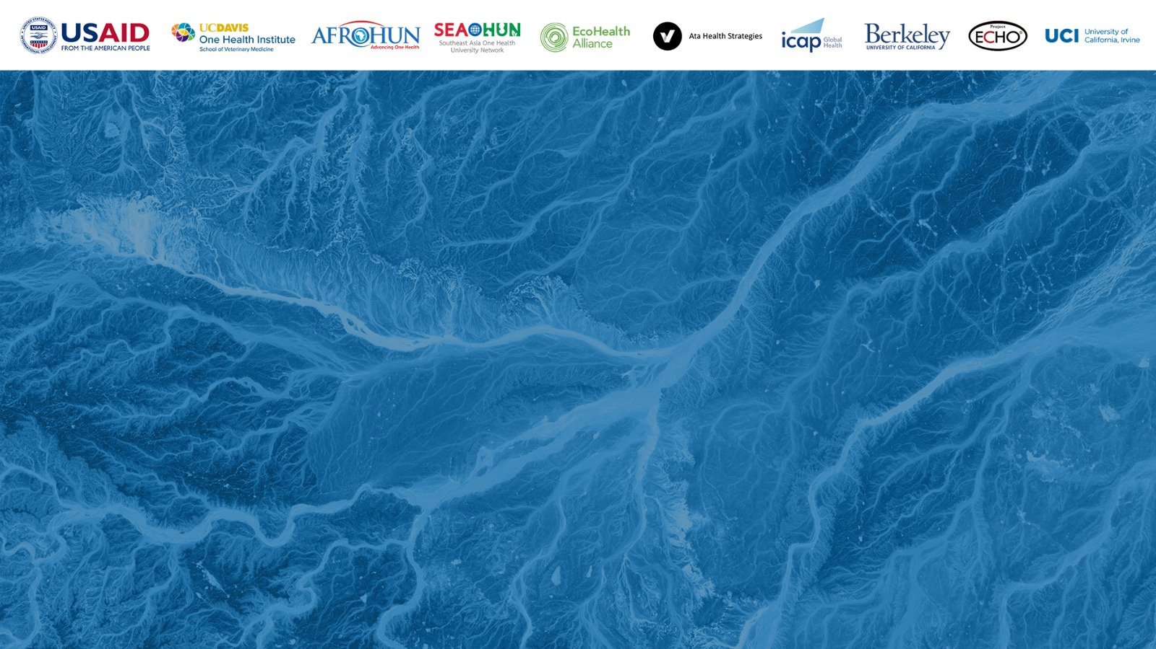
ONE HEALTH WORKFORCE ACADEMIES
A One Health Approach to Risk Assessment
One Health Supplemental Course Materials

Slide 2
Opening Questions
1. What does the word “risk” mean to you?
2. What are some examples of risks you are aware of in your own environment or routine?
3. When you make decisions about activities that involve risk, what information do you use to help inform those decisions?

Slide 3
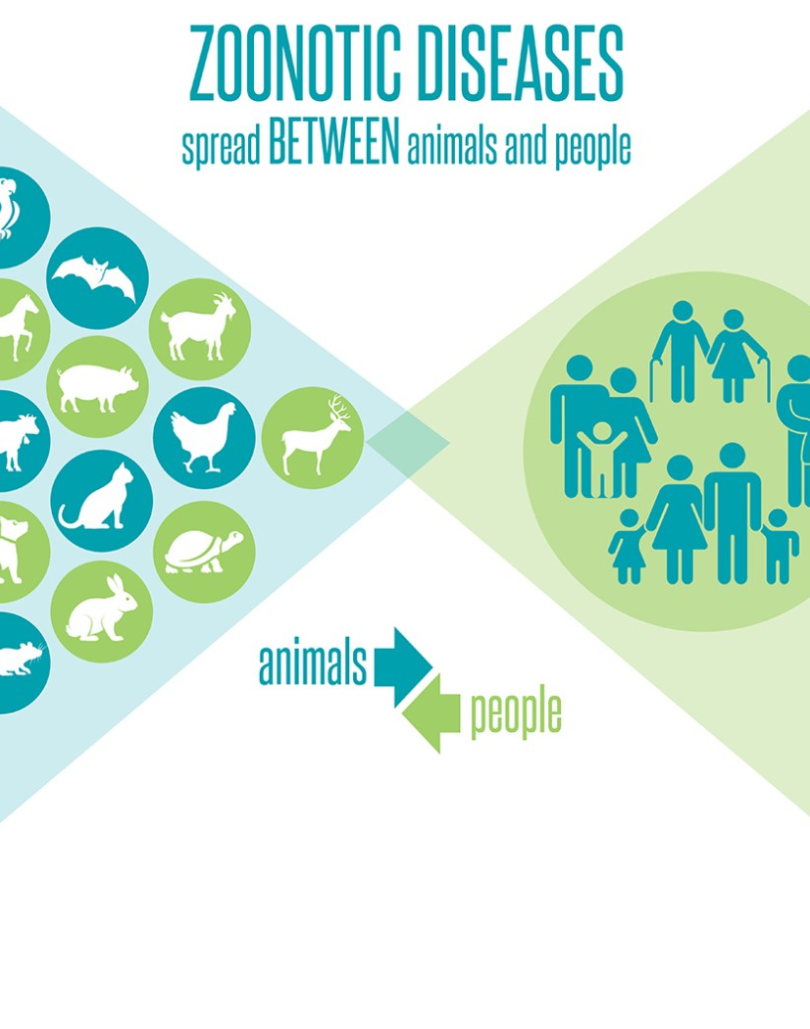
Session 1: Principles of Risk Assessment
Zoonotic Diseases and The One Health approach
(Image: Centers for Disease Control and Prevention)

Slide 4
Principles of Risk Assessment
Risk assessment is the practice of gathering, evaluating, and documenting information to estimate threat levels for a specific event bounded by time and location.
In the context of One Health, risk assessment is often used in the context of zoonotic disease.

Slide 5
Zoonotic Disease
Diseases of animal origin that are transmissible to humans, such as avian influenza, rabies, Rift Valley fever and brucellosis, pose worldwide risks to public health.
These risks are increasing with trade globalization, global warming and changes in human behavior, all of which provide multiple opportunities for pathogens to colonize new territories and evolve into new forms.
60% of pathogens that cause human diseases come from domestic animals or wildlife.
75% of emerging human pathogens are of animal origin.
80% of pathogens that are of concern for bioterrorism originate in animals

Slide 6
Components of Risk Assessment
Assessment of likelihood:
The probability that an event will occur.
Assessment of impact:
The magnitude of the harm that could be caused by the event.

Slide 7
Methods of Risk Assessment
Risk assessments can be qualitative, quantitative or a combination of both.
Quantitative assessments: are expressed using numbers generated from data sources. Missing data are estimated using models.
Qualitative assessments: use descriptive sets of categories (low, medium, high) with clear definitions for each. Qualitative assessments can often be accomplished more quickly and are appropriate where data are limited.

Slide 8
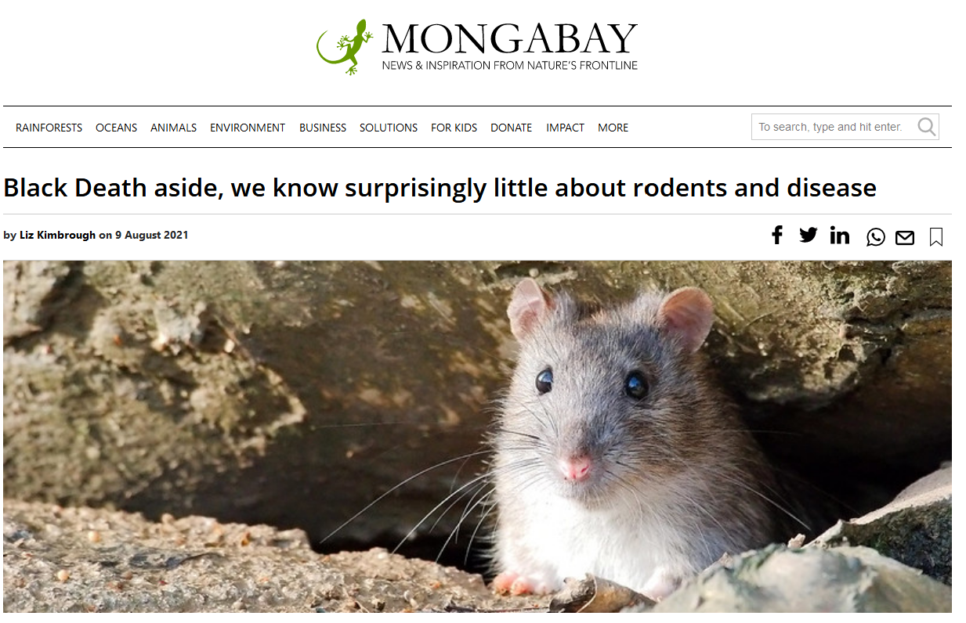
Activity 1
Reading and Discussion
Source: https://news.mongabay.com/2021/08/black-death-aside-we-know-surprisingly-little-about-rodents-and-disease/

Slide 9





Discussion Questions
Describe the risks you identified when reading the article.
Share your thoughts on the different groups or stakeholders that could have an interest in the assessment of risk related to rodent carried zoonotic disease?
How do you think a risk assessment that is narrowly focused on one of these sectors might be incomplete or have adverse consequences?
Share your ideas on strategies for incorporating multiple perspectives into the risk assessment process?
Describe the benefits and challenges of implementing these strategies?

Slide 10
Joint Risk Analysis
Sector-specific risk assessments are important ways for the human health, animal health, and environment sectors to manage risks related to their sector within their sectoral context, perspectives, priorities, and mandates.
For health concerns at the human–animal–environment interface, multiple sectors and disciplines must work together.
Bringing together information and expertise from all relevant sectors for the joint assessment of health risks from zoonotic disease allows for the management of shared risks at the human–animal–environment interface with coordinated responses.
https://www.who.int/initiatives/tripartite-zoonosis-guide/joint-risk-assessment-operational-tool

Slide 11
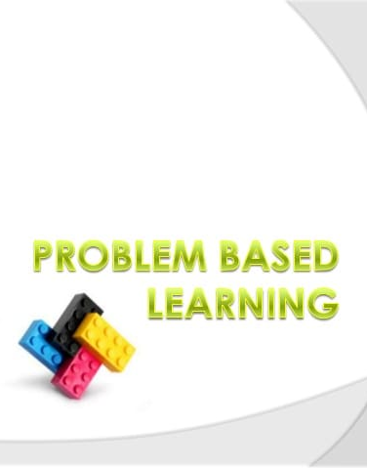
Session 2: Introduction to PBL
This Photo by Unknown Author is licensed under CC BY

Slide 12
Opening Questions
In your experience, what are some behaviors that help group projects to be successful?
In your experience, what are some behaviors that make group projects unsuccessful?
Can you share an experience of a successful or unsuccessful group project?

Slide 13
Group Work Ground Rules

Slide 14
Role of the Facilitator in PBL
The primary role of faculty is to facilitate the learning process, facilitate group dynamics, serve as a resource.
Facilitators will directly disseminate only limited amounts of information to ensure understanding and provide students with context.
Students will be responsible for gathering, processing, analyzing, organizing, interpreting and communicating information and ideas.
Facilitators will support this process by encouraging discussion, inquiry, debate, research, collaboration.

Slide 15
Roles of the Students
Chairperson
Scribe
Timekeeper
What, if any, other roles do you think could be useful to include in this model?

Slide 16
Case Study: Rift Valley Fever
Since March 2016 to June 2018, 10 independent outbreaks of RVF have been detected in Uganda.
The outbreaks occurred in 10 districts and involved 16 human cases of whom 7 died (CFR = 44%).
From investigations conducted in Kabale district following RVF outbreak in 2016, cattle, goats, and sheep had a seroprevalence of 27% (86/324), 7% (40/569) and 4% (7/158), respectively.

Slide 17
Case Study: Rift Valley Fever
Of the 655 human blood samples that were collected, anti-RVFV IgG was detected in 78 (12%) human samples. Seropositivity for RVF was greater in participants who were butchers (OR = 5.1; 95% CI 1.7-15.1) and those who reported handling raw meat (OR 3.4; 95% CI 1.2-9.8).
Some mosquitoes collected during the investigations were RT-PCR positive for RVF.
The RVF virus circulating in Uganda is similar to that of the East Africa 2006-2007 Kenya-2 outbreak lineage.

Slide 18
Problem
What is the risk of another RVF outbreak impacting the health of humans, livestock, or wildlife in Uganda?

Slide 19
Group Questions:
What types of experts would be well suited to serve on a team investigating the RVF case study?
What types of background information would each of these experts need to provide to the process?

Slide 20
Information needs
Animal Health
Human Health
Environmental Health
Other
Notes:
What types of experts would be well suited to serve on a team investigating the RVF case study?
What types of background information would each of these experts need to provide to the process?

Slide 21
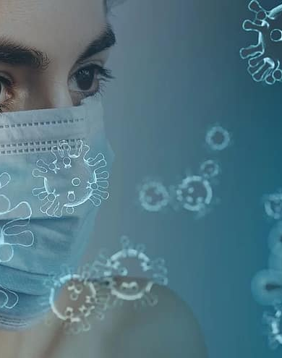
Module 3:Pathogens

Slide 22
Opening Questions
What does the term ‘pathogen’ mean to you?
Describe some things you would need to understand about a pathogen to be able to evaluate risk of disease events occurring?

Slide 23
Group Task: Pathogen Model
Conduct research to collect information about the pathogen responsible for causing Rift Valley Fever.
The information included should allow you to understand how this pathogen behaves as a disease-causing agent.
Organize this information into a model that could be used to communicate this information to stakeholders who do not know anything about the pathogen or how it behaves.
The model should be one that could be used for other pathogens as well – in other words, it should provide a framework that you could use to characterize any disease-causing agent of interest.

Slide 24
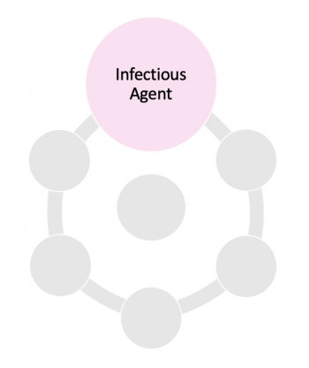
Module 4: Characterizing RVFV
This Photo by Unknown Author is licensed under CC BY-NC

Slide 25
Opening Questions
When collecting and organizing information about RVFV, what were some of the categories of information you decided to include in your model?
Were there categories of information you decided to leave out of your model? Why or why not?

Slide 26
Chain of Infection
Infectious Agent
Reservoirs
Portal of Exit
Modes of Transmission
Portal of Entry
Susceptible Host
https://professionals.wrha.mb.ca/old/extranet/ipc/files/manuals/ltc/ManualPCH_Sec03.pdf
Notes:
Understanding the chain of infection is fundamental to performing risk assessment.
Understanding the pathogen.

Slide 27
Infectious Agent
Infectious agent is a microorganism with the ability to cause infectious disease. The greater the organism’s virulence (ability to grow and multiply), invasiveness (ability to enter tissue) and pathogenicity (ability to cause disease) the greater the risk that the microorganism will cause an infectious outbreak.
Infectious agents include: bacteria, viruses, fungi and parasites.
Infectious Agent
Reservoirs
Portal of Exit
Modes of Transmission
Portal of Entry
Susceptible Host
https://professionals.wrha.mb.ca/old/extranet/ipc/files/manuals/ltc/ManualPCH_Sec03.pdf
Notes:
Understanding the chain of infection is fundamental to performing risk assessment.
Links in the chain of infection:
Infectious agent is a microorganism with the ability to cause infectious disease. The greater the organism’s virulence (ability to grow and multiply), invasiveness (ability to enter tissue) and pathogenicity (ability to cause disease) the greater the risk that the microorganism will cause an infectious outbreak. Infectious agents include: bacteria, viruses, fungi and parasites.
Reservoirs are places where infectious agents can thrive and reproduce. Examples include: human bodies, animal bodies, insect bodies, or inanimate objects like bodies of water or soil.
Portal of exit is the way for the infectious agent to leave the reservoir.
Modes of transmission are the routes or methods by which the infectious agent moves or is carried from one place to another to reach a new host. The modes of transmission are:
Contact – both direct contact between humans or between animals and humans and indirect contact where a common object is touched by both the original host (who leaves infectious agents behind on the surface) and a new host who picks up the IAs after touching the same surface.

Slide 28
Reservoirs
Reservoirs are places where infectious agents can thrive and reproduce.
Examples include: human bodies, animal bodies, insect bodies, or inanimate objects like bodies of water or soil.
Infectious Agent
Reservoirs
Portal of Exit
Modes of Transmission
Portal of Entry
Susceptible Host
https://professionals.wrha.mb.ca/old/extranet/ipc/files/manuals/ltc/ManualPCH_Sec03.pdf
Notes:
Understanding the chain of infection is fundamental to performing risk assessment.
Links in the chain of infection:
Infectious agent is a microorganism with the ability to cause infectious disease. The greater the organism’s virulence (ability to grow and multiply), invasiveness (ability to enter tissue) and pathogenicity (ability to cause disease) the greater the risk that the microorganism will cause an infectious outbreak. Infectious agents include: bacteria, viruses, fungi and parasites.
Reservoirs are places where infectious agents can thrive and reproduce. Examples include: human bodies, animal bodies, insect bodies, or inanimate objects like bodies of water or soil.
Portal of exit is the way for the infectious agent to leave the reservoir.
Modes of transmission are the routes or methods by which the infectious agent moves or is carried from one place to another to reach a new host. The modes of transmission are:
Contact – both direct contact between humans or between animals and humans and indirect contact where a common object is touched by both the original host (who leaves infectious agents behind on the surface) and a new host who picks up the IAs after touching the same surface.

Slide 29
Portal of Exit
Portal of exit is the way for the infectious agent to leave the reservoir.
Examples include: through the nasal passages or respiratory tract, via bodily fluids, or in feces.
Infectious Agent
Reservoirs
Portal of Exit
Modes of Transmission
Portal of Entry
Susceptible Host
https://professionals.wrha.mb.ca/old/extranet/ipc/files/manuals/ltc/ManualPCH_Sec03.pdf
Notes:
Understanding the chain of infection is fundamental to performing risk assessment.
Links in the chain of infection:
Infectious agent is a microorganism with the ability to cause infectious disease. The greater the organism’s virulence (ability to grow and multiply), invasiveness (ability to enter tissue) and pathogenicity (ability to cause disease) the greater the risk that the microorganism will cause an infectious outbreak. Infectious agents include: bacteria, viruses, fungi and parasites.
Reservoirs are places where infectious agents can thrive and reproduce. Examples include: human bodies, animal bodies, insect bodies, or inanimate objects like bodies of water or soil.
Portal of exit is the way for the infectious agent to leave the reservoir.
Modes of transmission are the routes or methods by which the infectious agent moves or is carried from one place to another to reach a new host. The modes of transmission are:
Contact – both direct contact between humans or between animals and humans and indirect contact where a common object is touched by both the original host (who leaves infectious agents behind on the surface) and a new host who picks up the IAs after touching the same surface.

Slide 30
Modes of Transmission
Routes or methods by which the infectious agent moves or is carried from one place to another to reach a new host.
Direct contact between humans or between animals and humans and indirect contact where a common object is touched by both the original host (who leaves infectious agents behind on the surface) and a new host who picks up the IAs after touching the same surface.
When large droplets (> 5 microns in diameter) are expelled from the respiratory tract during coughing or sneezing).
Microorganisms transmitted by the airborne route are carried by dust or other small particles floating in the air and are <5 microns in size. These microorganisms remain suspended in the air and are widely dispersed by air currents.
Vectorborne transmission refers to infections caused by animals and insects.
Common vehicle transmission refers to transmission through a contaminated source such as food or medicine.
Infectious Agent
Reservoirs
Portal of Exit
Modes of Transmission
Portal of Entry
Susceptible Host
https://professionals.wrha.mb.ca/old/extranet/ipc/files/manuals/ltc/ManualPCH_Sec03.pdf
Notes:
Understanding the chain of infection is fundamental to performing risk assessment.
Links in the chain of infection:
Infectious agent is a microorganism with the ability to cause infectious disease. The greater the organism’s virulence (ability to grow and multiply), invasiveness (ability to enter tissue) and pathogenicity (ability to cause disease) the greater the risk that the microorganism will cause an infectious outbreak. Infectious agents include: bacteria, viruses, fungi and parasites.
Reservoirs are places where infectious agents can thrive and reproduce. Examples include: human bodies, animal bodies, insect bodies, or inanimate objects like bodies of water or soil.
Portal of exit is the way for the infectious agent to leave the reservoir.
Modes of transmission are the routes or methods by which the infectious agent moves or is carried from one place to another to reach a new host. The modes of transmission are:
Contact – both direct contact between humans or between animals and humans and indirect contact where a common object is touched by both the original host (who leaves infectious agents behind on the surface) and a new host who picks up the IAs after touching the same surface.

Slide 31
Portal of Entry
Portal of Entry is the means by which infectious agents gain access to a new host
Examples include: wounds, airways or sexual contact or ingestion.
Infectious Agent
Reservoirs
Portal of Exit
Modes of Transmission
Portal of Entry
Susceptible Host
https://professionals.wrha.mb.ca/old/extranet/ipc/files/manuals/ltc/ManualPCH_Sec03.pdf
Notes:
Understanding the chain of infection is fundamental to performing risk assessment.
Links in the chain of infection:
Infectious agent is a microorganism with the ability to cause infectious disease. The greater the organism’s virulence (ability to grow and multiply), invasiveness (ability to enter tissue) and pathogenicity (ability to cause disease) the greater the risk that the microorganism will cause an infectious outbreak. Infectious agents include: bacteria, viruses, fungi and parasites.
Reservoirs are places where infectious agents can thrive and reproduce. Examples include: human bodies, animal bodies, insect bodies, or inanimate objects like bodies of water or soil.
Portal of exit is the way for the infectious agent to leave the reservoir.
Modes of transmission are the routes or methods by which the infectious agent moves or is carried from one place to another to reach a new host. The modes of transmission are:
Contact – both direct contact between humans or between animals and humans and indirect contact where a common object is touched by both the original host (who leaves infectious agents behind on the surface) and a new host who picks up the IAs after touching the same surface.

Slide 32
Susceptible Host
A susceptible host is a person or animal who is vulnerable to the infectious agent.
Infectious Agent
Reservoirs
Portal of Exit
Modes of Transmission
Portal of Entry
Susceptible Host
https://professionals.wrha.mb.ca/old/extranet/ipc/files/manuals/ltc/ManualPCH_Sec03.pdf
Notes:
Understanding the chain of infection is fundamental to performing risk assessment.
Links in the chain of infection:
Infectious agent is a microorganism with the ability to cause infectious disease. The greater the organism’s virulence (ability to grow and multiply), invasiveness (ability to enter tissue) and pathogenicity (ability to cause disease) the greater the risk that the microorganism will cause an infectious outbreak. Infectious agents include: bacteria, viruses, fungi and parasites.
Reservoirs are places where infectious agents can thrive and reproduce. Examples include: human bodies, animal bodies, insect bodies, or inanimate objects like bodies of water or soil.
Portal of exit is the way for the infectious agent to leave the reservoir.
Modes of transmission are the routes or methods by which the infectious agent moves or is carried from one place to another to reach a new host. The modes of transmission are:
Contact – both direct contact between humans or between animals and humans and indirect contact where a common object is touched by both the original host (who leaves infectious agents behind on the surface) and a new host who picks up the IAs after touching the same surface.

Slide 33
Chain of Infection for Rift Valley Fever

Slide 34
Reflection Questions
Discuss what you see as the strengths and weaknesses of the Chain of Infection model.
Share any categories of information you decided to include in your model that are not included in the Chain of Infection model.

Slide 35
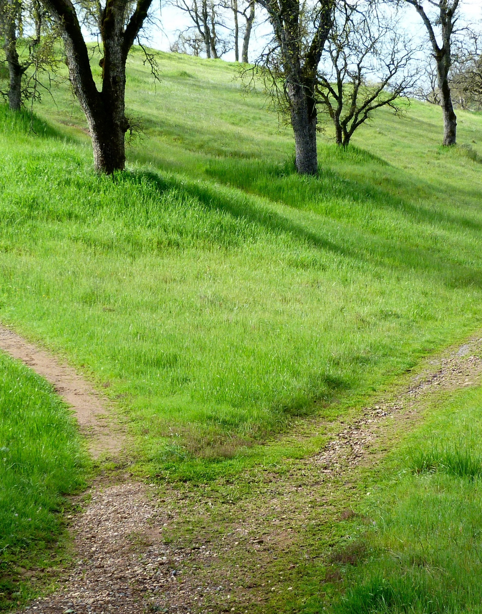
Module 5: Risk Pathways

Slide 36
Opening Questions
What does the phrase risk pathway mean to you?
Describe how you think context and sequence might be important in defining risk pathways.
Describe what you imagine a risk pathway diagram might communicate? How might it be presented visually?

Slide 37
Group Task
Determine the Risk Pathways for the transmission of RVFV within Uganda include pathways that could have health consequences for humans, livestock and wildlife.
Include all biologically possible pathways – even those that seem unlikely given regulations or geo-political context.

Slide 38
Group Task
Create 3 Risk Pathway Diagrams. One for each of the following end points.
1. Infected Human
2. Infected Livestock
3. Infected Wildlife

Slide 39
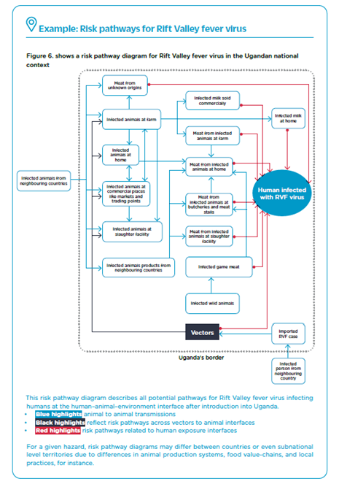

Slide 40

Module 6: Risk Assessment Questions

Slide 41
Opening Questions
Looking at your Risk Pathway diagrams, how would you describe the array of risks you identified?
Explain how you might use your Risk Pathway diagrams as a resource in risk assessment.

Slide 42
Problem
You have presented your Risk Pathway Diagrams to the Ugandan Ministry of Health.
They have asked you to work on a risk assessment scenario for human and animal health outcomes due to RVFV among the population of Karamojong people in the Northeastern Karamoja region of Uganda.
They would like you to consider the environmental effect of rainfall/seasonality in your assessment.
The results of your assessment will inform their risk prevention and mitigation strategy.

Slide 43
Discussion Questions
Describe what you believe the next steps might be in the risk assessment process?
Explain how you think the Risk Pathway diagrams will be useful to the task you have been asked to accomplish?
What additional information would you need to continue with the problem?
In what ways are the Risk Pathways not suitable for this task?

Slide 44
Group Task
Review your pathway diagrams. From those pathways you will craft a specific risk assessment question that when fully investigated will yield actionable results.
While crafting your question, you will need to collect supporting information about the people, animals and environment of the Karamoja region.
The goal of crafting risk assessment questions is to identify a specific context for your risk assessment such that the results of the assessment will be useful to your stakeholders.

Slide 45
What is the likelihood and impact of nomadic herders in the Moroto district becoming critically ill from exposure to RVFV during cattle drives in the rainy season and the dry season?
What is the likelihood and impact of:
 | Outcome (illness, death, abortion, etc.)
WHY | Pathogen
WHERE | Location (district, township)
WHO | Population (goats, cattle, sheep, adults, children, farmers, butchers, etc.)
WHEN | Timeframe (in the rainy season/in the dry season)
HOW | Source of Exposure (live animal market, water source, slaughterhouse, on farm etc.)
Source: Modified from the Joint Risk Assessment Operational Tool (JRA OT)

Slide 46

Module 7:
Qualitative Likelihood Assessment
This Photo by Unknown Author is licensed under CC BY-NC-ND

Slide 47
Opening Questions
In reviewing your finalized risk assessment questions, describe what you believe could be the next steps in the risk assessment process?
In the context of your risk assessment question, what does the term likelihood mean to you?
Explain the types of information you will need to assess the likelihood of the outcome defined in your risk assessment questions.
Describe any challenges you foresee with making estimates of likelihood.

Slide 48
Group Discussion Prompt
Develop a process for performing a qualitative assessment of the following question:
What was the likelihood that a 10-year-old child in Davidson County Tennessee will require hospitalization from exposure to the Covid-19 coronavirus while attending school in September 2021?

Slide 49
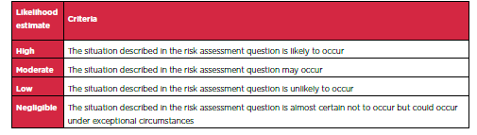
Estimating Likelihood: JRA-OT Approach
Describe your assessment of this approach – what are the strengths and weaknesses?

Slide 50
Group Task
Provide a complete qualitative assessment of the likelihood that the event described in your risk assessment question will occur.
Your findings should include a comparison of risks in rainy and dry conditions.
Prepare a document that describes and explains your findings in narrative format including graphical elements as necessary. Clearly describe all data used to support your findings and cite all sources.
This document will be presented to your stakeholders, including the Ugandan Ministry of Health and will guide decisions about risk preparation and mitigation efforts.
Using the process you developed in the Covid-19 thought exercise, information from the JRA-OT process, and any additional sources or approaches you choose to incorporate.

Slide 51
Module 8:
Qualitative Impact Assessment
This Photo by Unknown Author is licensed under CC BY-NC-ND

Slide 52
Opening Questions
In the context of your risk assessment question, what does the term impact mean to you?
Describe the different domains that could be considered when assessing impact.
Explain the types of data you will need to assess the impact of the outcome defined in your risk assessment question.
Explain how you might use the process you developed for estimating likelihood to complete a qualitative assessment of impact.
Describe any challenges you foresee with making estimates of impact.

Slide 53
Problem
Develop a process for performing a qualitative impact assessment.
The impact domains of interest are regional population health and socio-economic impacts for the Karamojong people.

Slide 54
Group Task
Provide a complete qualitative assessment of the impact that the event described in your risk assessment question will have should it occur.
Your findings should include a focus on impacts relating to the health of the regional population and the socio-economic impacts on the Karamojong people.
Prepare a document that describes and explains your findings in narrative format including graphical elements as necessary. Clearly describe all data used to support your findings and cite all sources.
This document will be presented to your stakeholders, including the Ugandan Ministry of Health and will guide decisions about risk preparation and mitigation efforts.

Slide 55
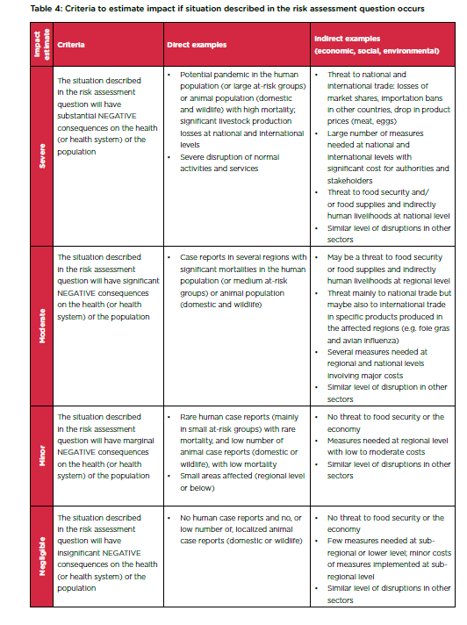
Estimating Impact: JRA-OT Approach
Describe your assessment of this approach – what are the strengths and weaknesses?

Slide 56
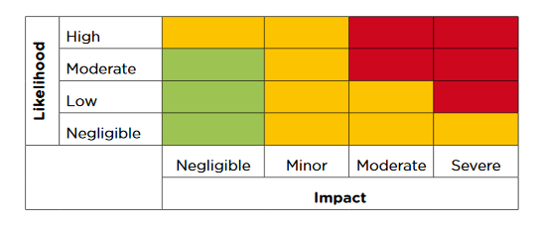
Risk Assessment Matrix: JRA-OT

Slide 57
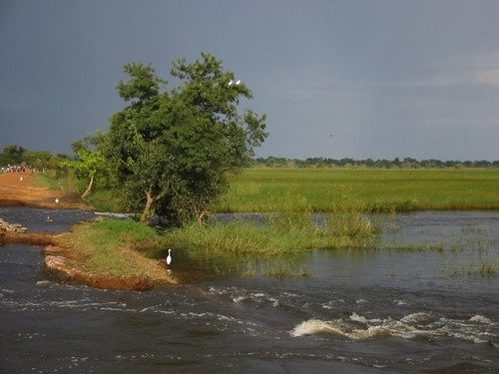
Module 9:
Climate Change
Challenge
This Photo by Unknown Author is licensed under CC BY-NC-ND

Slide 58
Opening Questions
Explain your understanding of the difference between weather and climate.
Explain your understanding of the types of impacts climate change will have on average temperatures and weather events.
Explain your understanding of the types of impacts climate change will have on animals, people and the environment

Slide 59
Problem
Climate change is projected to increase temperatures and impact water availability across Uganda.
Some areas expected to experience flooding due to increased intensity of rainfall (central and southern regions), as well as the continued aridity and increased frequency of droughts for others (north, northeastern, west and southwestern regions).
Key sectors such as, agriculture, health, water resources, wetlands, and forests are vulnerable to these climate change impacts in Uganda.
These changes may also alter risk profiles for zoonotic diseases such as RVFV.

Slide 60
Group Task
Groups are tasked with adding an addendum to their risk assessment reports which will provide the Ministry of Health with the information they need to understand how the likelihood and impacts may be affected by the effects of climate change.
Students should evaluate each component of their assessment and provide commentary as to how the effects of climate change on temperature and precipitation could modify the identified risks and shift their likelihood or impact (positively or negatively) over the next 50 years.

Slide 61
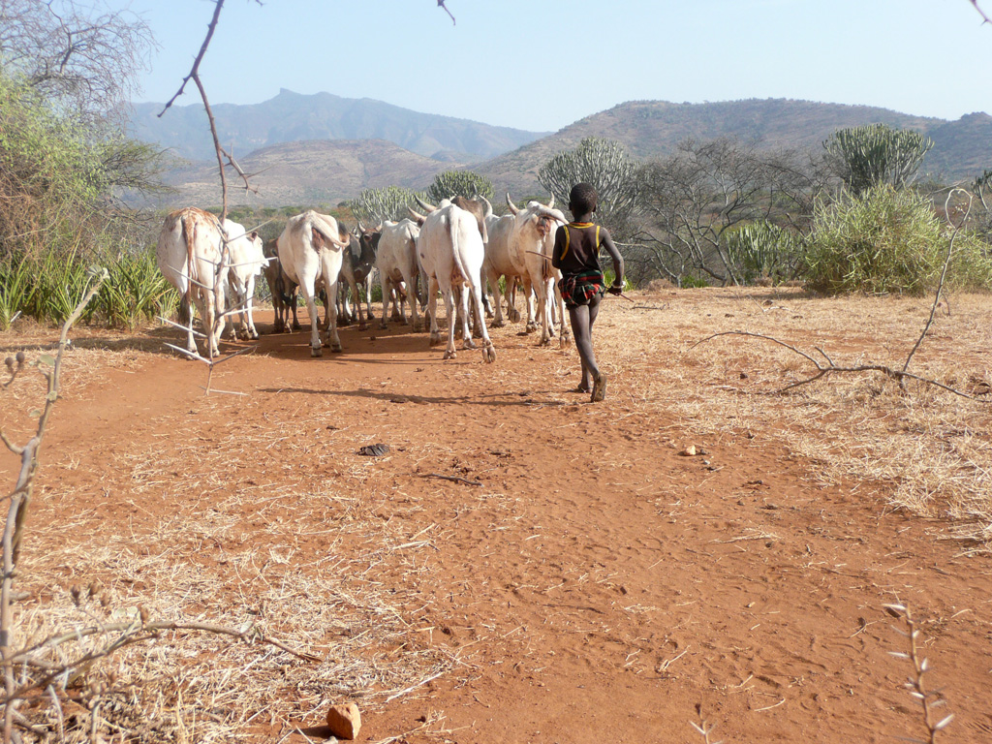
Module 10:
Communication and Mitigation
This Photo by Unknown Author is licensed under CC BY-SA-NC

Slide 62
Opening Questions
Now that you have completed your Risk Assessment reports, explain how you think these documents would be most useful to your stakeholders?
In addition to the Ugandan Ministry of Health, describe any other groups you believe risk assessments of these nature would benefit?
Explain what you think the next steps might be in making these reports useful and meaningful?
Explain the types of questions or concerns your stakeholders might have about your findings.

Slide 63
Group Discussion Questions
Share what the phrase “risk mitigation” means to you.
Explain what you believe to be the difference between short-term and long-term risk mitigation strategies.

Slide 64
Problem
The Ministry of Health has tasked you with developing a comprehensive set of risk mitigation strategies that will benefit stakeholders.
Each group will propose 2 strategic categories that address top concerns not only for your risk assessment question, but across all questions that were presented.
Strategies should take into consideration the questions of the stakeholders as well as the environmental, social and economic conditions of the Karamoja region.
For each category provide a short-term solution, a longer-term solution and a climate change consideration.

Slide 65
Example Strategies from the JRA-OT
*Climate Change Consideration is our addition.
Short Term Vector Control: Farmers should use insect repellent to spray their animals.
Long Term Vector Control: Stakeholders should identify and encourage use of existing biological control measures for vectors that are environmentally friendly.
Climate Change Consideration*: Establishing vector-free water sources that are accessible and spread throughout the cattle corridors.

