Slide 1


ONE HEALTH WORKFORCE ACADEMIES
Climate Change & One Health:
Climate Science Foundations
Instructor: Kathryn C. Conlon, Ph.D., M.P.H
UC Davis Schools of Medicine Department of Public Health Sciences and School of Veterinary Medicine Department of Medicine and Epidemiology

Slide 2
Learning Objectives
Differentiate weather and climate processes
Explain the relationship between greenhouse gas emissions and global climate change
Describe evidence of global climate change
Discuss how global climate models are used to understand global climate change
Notes:
.

Slide 3
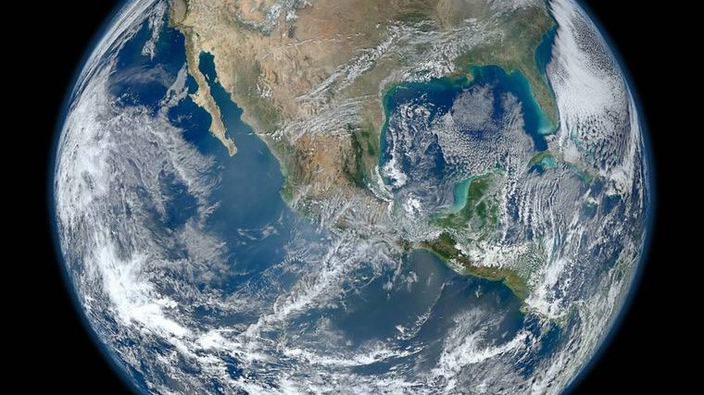
What is Climate Change?

Slide 4


Slide 5
Important Terminology
Weather
Short-term (i.e., minutes, hours, days, weeks) atmospheric conditions
Climate Change
Long-term continuous change (increase or decrease) to average weather conditions or the range of weather
Climate Variability
The way climate fluctuates yearly above or below a long-term average value
Climatological Normal
30-year average of a weather variable
Anomaly
Departure from a reference value or long-term average
Positive – Observed temp higher than the average
Negative – Observed temp lower than the average

Slide 6
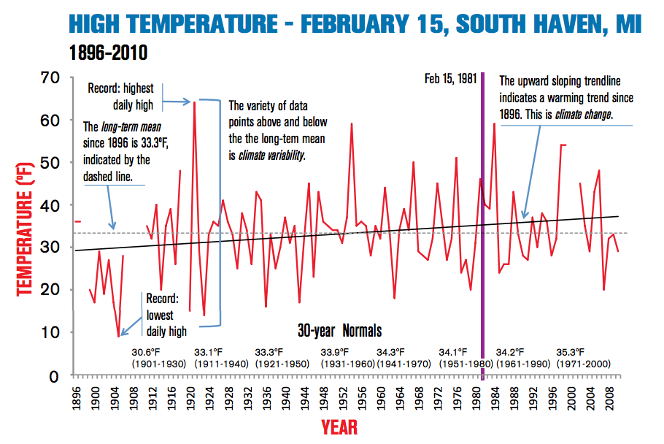
Adapted from: Michigan Sea Grant, 2013
Notes:
Scientists think of climate variability as the way climate fluctuates yearly above or below a long-term average value. You can think of it as a story with two parts: average and range. These parts complement each other; understanding the range gives context to the average and vice versa
These 30-year averages are called climatological normals, and are used to determine, monitor or represent the climate – or a specific slice of climate – at a particular location
There is significant year-to-year variability around these 30-year averages.
Climate variability – The way climate fluctuates yearly above or below a long-term average value.
Climate change – Long-term continuous change (increase or decrease) to average weather conditions or the range of weather.
Climatological normal – 30-year average of a weather variable
Weather
Short-term (i.e., minutes, hours, days, weeks) atmospheric conditions
Climate Change
Long-term continuous change (increase or decrease) to average weather conditions or the range of weather
Climate Variability
The way climate fluctuates yearly above or below a long-term average value
Climatological Normal
30-year average of a weather variable
Anomaly Departure from a reference value or long-term average
Positive – Observed temp higher than the average
Negative – Observed temp lower than the average

Slide 7
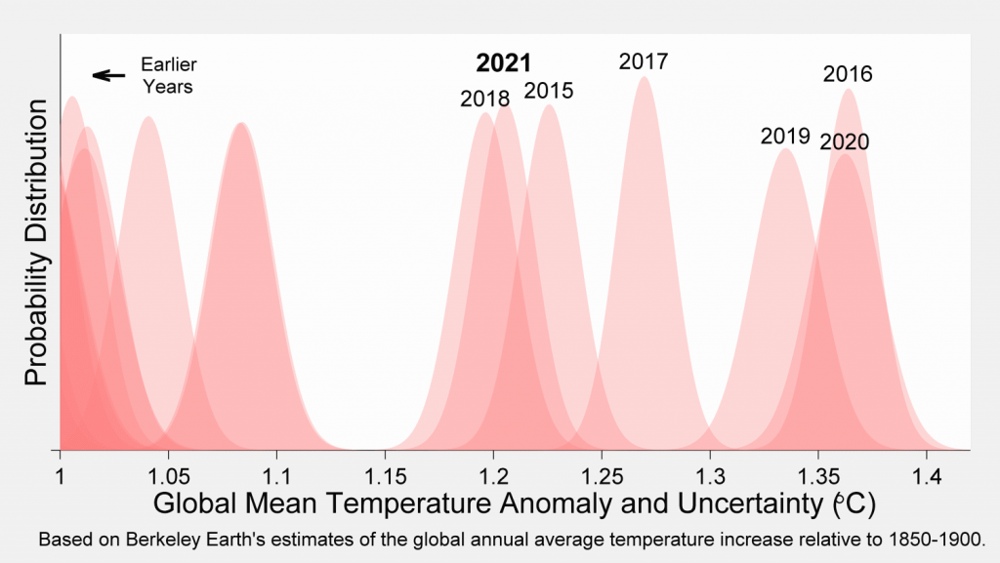
Temperature Anomalies
http://berkeleyearth.org/global-temperature-report-for-2021
Notes:
Climate anomalies are basically current climate condition put in the context of past events. For example here, they used the 1850-1900 normals period to determine anomalies. The last seven years stand out as the seven warmest years to have been directly observed.
The last seven years have been part of a period of significant warmth well above all previous years since 1850. This reflects the long-term trend towards global warming. Though 2021 is cooler than some of the other recent years, its overall temperature remains consistent with the long-term warming trend. 2021 was the sixth warmest year on Earth since 1850

Slide 8
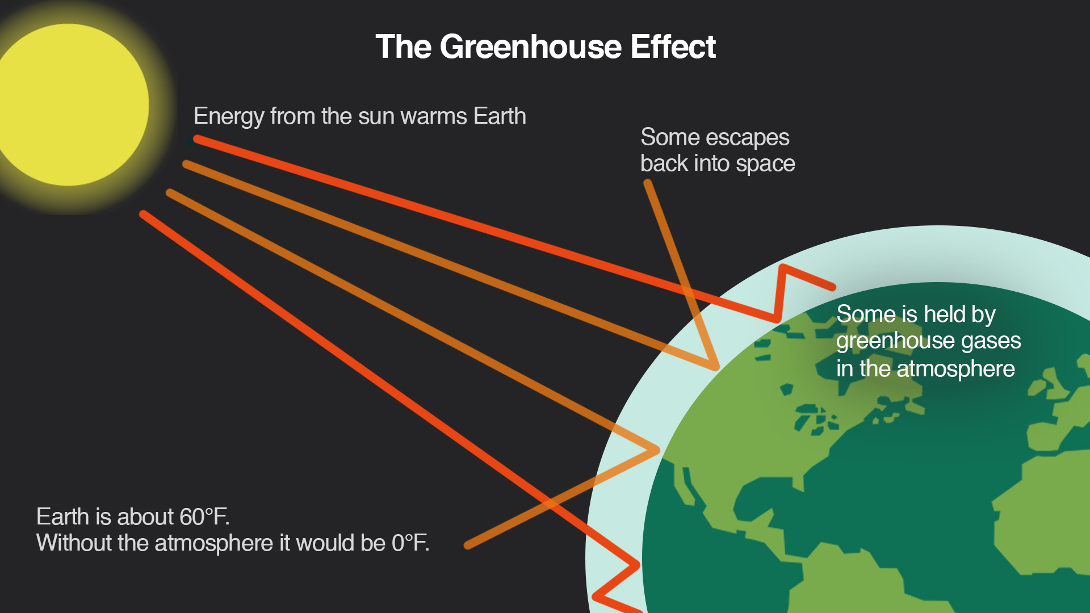
Greenhouse Effect
Climate Central, 2018
Notes:
The greenhouse effect is a process that occurs when energy – in the form of heat from the Sun – is trapped close to Earth’s surface by greenhouse gases. These gases are important; they can be thought of as a blanket that wraps the earth in warmth.
Human activities, specifically emissions of certain gases and landcover changes, have intensified the greenhouse effect, disrupting the natural energy balance of the Earth-Atmosphere system.
Yellow is solar, shortwave radiation,
while orange is infrared, longwave radiation, also known as heat.
Irradiance is the radiant flux (power) received by a surface per unit area. The SI unit of irradiance is the watt per square metre (W/m²).
Earth-Atmosphere System is in balance over a year + numbers.
A portion of shortwave radiation is absorbed by (the atmosphere and) the Earth’s surface, then re-radiated as longwave radiation back towards space
BUT! greenhouse gases absorb some of this longwave radiation and back radiate (or re-radiate) this lower energy longwave radiation back towards the Earth’s Surface. Eventually, this energy does make it back out to space.
Any changes to the Earth’s climate system that affect how much energy enters or leaves the system alters Earth’s radiative equilibrium and can force temperatures to rise or fall. These destabilizing influences are called climate forcings.
SOLAR RADIATION Atmosphere ***343 incoming
On average and over the long term, the Earth-Atmosphere system is in radiative equilibrium, or in balance. That is, the amount of energy coming in from the sun is the same as the amount going out (from the reflection of the sun and emission of infrared radiation). ***343 incoming, 103 reflected, 240 net incoming, 240 net outgoing***
Insolation is absorbed, reflected, or transmitted by gases in the atmosphere.
This image does not show atmospheric absorption, as the atmosphere is not a good absorber of shortwave radiation, with only about 20% of the shortwave radiation absorbed by atmospheric gases. This percentage of shortwave radiation absorbed by the atmosphere is emitted as longwave radiation.
SOLAR RADIATION Reflection ***103 Watts per meter squared (both arrows for atmosphere and earth’s surface)***
The albedo, or reflectivity, of a surface is one factor that determines the ratio of incident solar radiation that is absorbed and reflected by the Earth’s surface. Albedo ranges from 0 to 1, with a value of one denoting complete reflection of all wavelengths. Bright surfaces with high albedo like snow and clouds, reflect almost all wavelengths of incoming radiation, while dark surfaces like asphalt absorb almost all wavelengths of incoming radiation.
Regarding the reflection of insolation, atmospheric gases, clouds, and the Earth’s surface reflect around 42% of the incoming solar radiation, leaving almost half of the solar radiation to be absorbed by the Earth’s surface.
The portion of insolation that is reflected by the Earth’s surface travels back into space, as the atmosphere is a poor absorber of shortwave radiation, whether shortwave radiation travels towards Earth or space
LAND SURFACE Absorption/emission
During the day, the land surface absorbs and stores a certain percentage of insolation. A percentage of the absorbed insolation that is stored in the surface material is emitted as longwave radiation, or infrared heat, raising the temperature in the troposphere. Unlike solar radiation, longwave radiation emitted by the Earth can take place all the time.
LAND SURFACE Longwave radiation
As this longwave radiation emitted from the Earth’s surface travels through the atmosphere, greenhouse gases like water vapor and carbon dioxide absorb a larger proportion of this lower-energy radiation than incoming or outgoing shortwave radiation. resulting in back radiation of thermal-infrared heat from the atmosphere towards the Earth’s surface. In essence, the back radiation of longwave radiation by atmospheric greenhouse gases allows the lower levels of the troposphere to be at temperatures that sustain life,
What do you think the average temperature of the Earth would be without naturally occurring greenhouse gases?
An atmosphere without naturally occurring greenhouse gases would exhibit average temperatures near 0°F

Slide 9
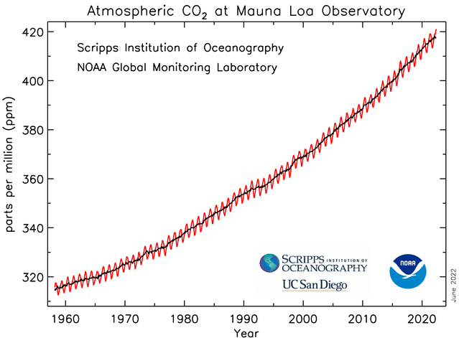
Trends in Atmospheric CO₂, 1968 – 2022
https://gml.noaa.gov/ccgg/trends/
Notes:
Monthly mean CO2 measured at Mauna Loa Observatory --- longest record of direct CO2 measurements in the atmosphere
Every monthly mean is the average of daily means, which are based on hourly averages.
The RED lines represent the monthly mean values. The black line represents the same, after correcting for seasonal cycle.

Slide 10
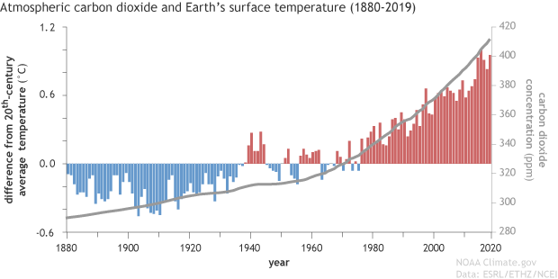
Evidence of Relationship Between CO₂ & Global Temperature
www.climate.gov
Notes:
So, what evidence do we have that there is a relationship between CO2 and global temperature?
Here, we are looking at yearly temperatures compared to the 20th century average (this is shown in the blue bars, red bars) from 1880 to 2019. Overlaid on top of this (grey line) are atmospheric carbon dioxide (CO2) concentrations.

Slide 11
Global Warming Potential of (GWP) of Primary Greenhouse Gases
Greenhouse Gas | Human Source | Lifetime (years) | GWP,100-year horizon
Carbon Dioxide (CO₂) | Fossil fuel combustion; land use changes; cement production | variable | 1
Methane (CH₄) | Fossil fuel combustion; rice paddies; waste dumps; livestock | 12.4 | 29.8 (fossil origin) 27.2 (non-fossil origin)
Nitrous Oxide (N₂O) | Fertilizer; industrial processes; fossil fuel combustion | 109 | 273
Hydroflourocarbon-32 (HFC-32) | Liquid coolants | 5.4 | 771
Trichlorofluoromethane (CFC-11) | Refrigerant | 52.0 | 6,226
Perflourocarbons (PFC-14) | Refrigerant; electronics and aluminum industries | 50,000 | 7,380
IPCC AR6, WG1 2021
Notes:
Greenhouse gases trap infrared radiation near the surface, warming the climate. These gases differ in their ability to absorb energy, that is, they have various radiative efficiencies. They also differ in their atmospheric residence times. Each gas has a specific global warming potential (GWP), which allows comparisons of the amount of energy the emissions of 1 ton of a gas will absorb over a given time period, usually a 100-year averaging time, compared with the emissions of 1 ton of CO₂.
CO2 remains by far the most important positive anthropogenic driver, with methane next most significant; anthropogenic methane stems from such sources as fossil fuel extraction, natural gas pipeline leakage, agriculture, and landfills
GWPs are multipliers applied to greenhouse gases such as methane (CH₄) and Nitrous Oxide (N₂O) to equate the impact they have on the Earth’s temperature with that of Carbon Dioxide (CO₂).
For instance, Pound for pound, the comparative impact of CH₄ is about 30 times greater than CO₂ over a 100-year period.
In the AR6 report, an additional GWP for methane has been included to differentiate between methane which originates from fossil fuel sources, and methane from non-fossil fuel sources, like agriculture.

Slide 12
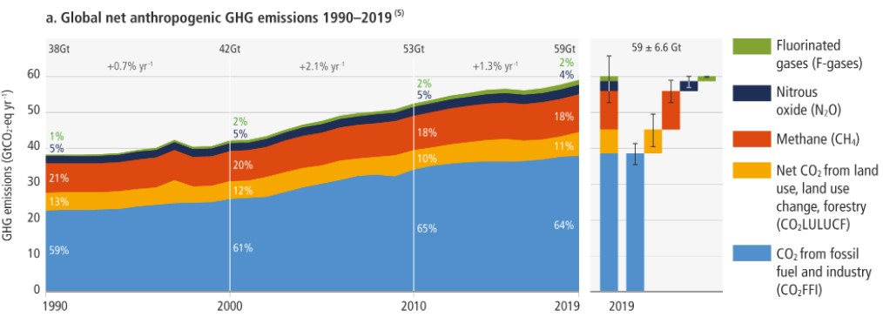
Global Greenhouse Gas Emissions, 1990 – 2019
IPCC, 2022
Notes:
This figure shows worldwide emissions of carbon dioxide, methane, nitrous oxide, and several fluorinated gases from 1990 to 2019.
Include examples of sources for each emission type
In 2015, estimated worldwide emissions from human activities totaled nearly 47 billion metric tons of greenhouse gases, expressed as carbon dioxide equivalents. This represents a 43 percent increase from 1990 (see Figures 1 and 2). These numbers represent net emissions, which include the effects of land use and forestry.
Between 1990 and 2015, global emissions of all major greenhouse gases increased. Net emissions of carbon dioxide increased by 51 percent, which is particularly important because carbon dioxide accounts for about three-fourths of total global emissions.
Methane emissions increased the least—17 percent—while emissions of nitrous oxide increased by 24 percent. Emissions of fluorinated gases more than tripled.
Energy production and use (including fuels used by vehicles and buildings) represent the largest source of greenhouse gas emissions worldwide (about 75 percent of the total in 2015), followed by agriculture (12 percent in 2015) (see Figure 2). While land-use change and forestry represent a net sink for emissions in the United States, absorbing carbon dioxide and offsetting emissions from other sources (see the U.S. Greenhouse Gas Emissions indicator), these activities are a net source of emissions on a global scale, largely because of deforestation.¹
Carbon dioxide emissions are increasing faster in some parts of the world (for example, East Asia and the Pacific) than in others (see Figure 3). The majority of emissions come from three regions: East Asia and Pacific, Europe and Central Asia, and the United States, which together accounted for 74 percent of total global emissions in 2018.
https://www.ipcc.ch/report/ar6/wg3/figures/summary-for-policymakers/IPCC_AR6_WGIII_FigureSPM1.png

Slide 13
MODELING GLOBAL CLIMATE CHANGE
Notes:
With this knowledge of the amount of greenhouse gases in our atmosphere, we can model global climate change

Slide 14
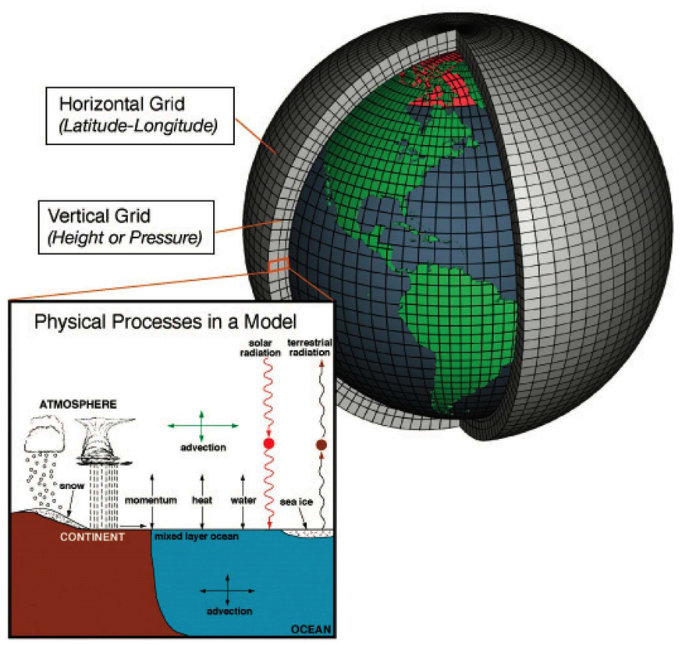
Understanding Climate Model Projections
Climate Model
Computer simulation that characterizes the Earth’s climate system by using mathematical equations to represent interactions of important climatic drivers like the atmosphere, oceans, land surface, and ice. They are used to study past climate or predict future climate.
Climate Forcing
The physical process of affecting Earth’s climate by natural and human-induced disturbances to Earth’s energy balance. Also referred to as ‘drivers’.
NOAA, 2015
Downscale
Process to estimate higher spatial resolution (i.e., more local) data using coarse resolution data from climate models
Notes:
Climate models are one of the primary means for scientists to understand how the climate has changed in the past and may change in the future. These models simulate the physics, chemistry and biology of the atmosphere, land and oceans in great detail, and require some of the largest supercomputers in the world to generate their climate projections
A global climate model (GCM) is a complex mathematical representation of the major climate system components (atmosphere, land surface, ocean, and sea ice), and their interactions. Earth's energy balance between the four components is the key to long-term climate prediction.
Main climate system components treated in a climate model are:
The atmospheric component, which simulates clouds and aerosols, and plays a large role in transport of heat and water around the globe.
The land surface component, which simulates surface characteristics such as vegetation, snow cover, soil water, rivers, and carbon storing.
The ocean component, which simulates current movement and mixing, and biogeochemistry, since the ocean is the dominant reservoir of heat and carbon in the climate system.
The sea ice component, which modulates solar radiation absorption and air-sea heat and water exchanges.

Slide 15
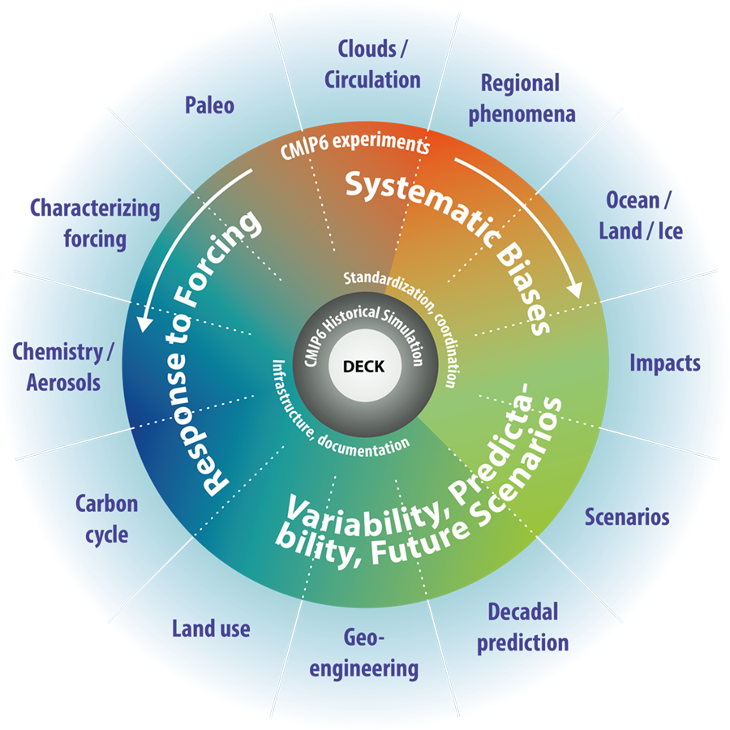
Coupled Model Intercomparison Project (CMIP)
Model Ensemble
A group of comparable climate model simulations.
Each model is slightly different from another; the ensemble average is expected to perform better than an individual model.
CMIP6
Coordinated efforts from CMIP.
Contains output from ~100 distinct climate models, produced by 49 modeling groups.
Eyring, et al, 2016
Notes:
The goal of CMIP is to generate a set of standard simulations that each model will run. This allows results to be directly comparable across different models, to see where models agree and disagree on future changes. One of the main sets of simulations run by models are future climate scenarios, where models are given a common set of future concentrations of greenhouse gases, aerosols and other climate forcings to project what might happen in the future.
Climate forcing is a measure of the ‘radiative forcing’ (or HEATING EFFECT) caused by greenhouse gases in the atmosphere.
Radiative forcing – the amount of warming or cooling that affects global energy balance; It’s calculated in watts/square meter, which represents the size of the energy imbalance in the atmosphere
Of the greenhouse gases in the atmosphere, CO2 accounts for the LARGEST SHARE of radiative forcing and continues to grow at steady rate.

Slide 16
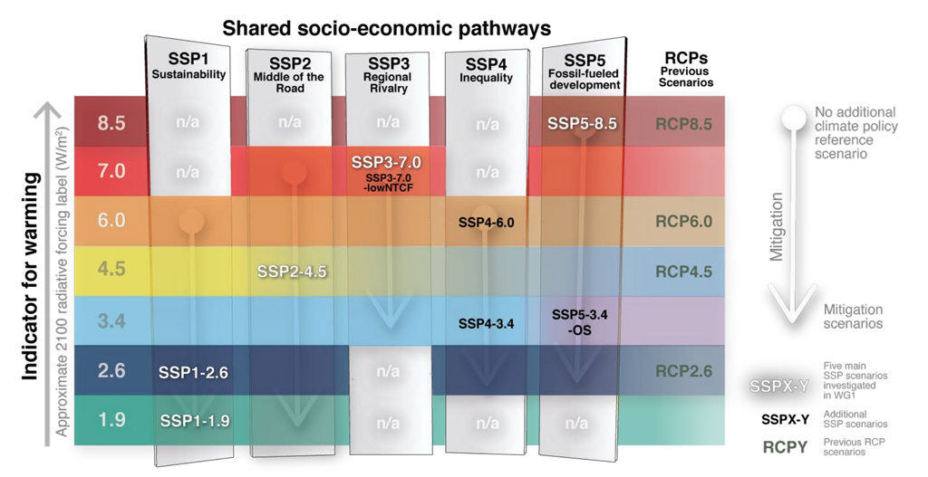
Climate Scenario Modeling
IPCC AR6, WG1 2021
Notes:
The energy modelling community has developed a new set of emissions scenarios driven by different socioeconomic assumptions, These are the “Shared Socioeconomic Pathways” (SSPs). A number of these SSP scenarios have been selected to drive climate models for CMIP6. A set of scenarios were chosen to provide a range of distinct end-of-century climate change outcomes.
SSP1-1.9: ​Holds warming to approximately 1.5C above 1850-1900 in 2100 “after slight overshoot” and implied net-zero CO2 emissions around the middle of the century.
SSP1-2.6: Stays below 2C warming with implied net-zero emissions in the second half of the century.
SSP2-4.5: (optimistic) Approximately in line with the upper end of combined pledges under the Paris Agreement. The scenario “deviates mildly from a ‘no-additional climate-policy’ reference scenario, resulting in a best-estimate warming around 2.7C by the end of the 21st century”.
SSP3-7.0: (middle-of-the-road scenario) A medium-to-high reference scenario resulting from no additional climate policy, with “particularly high non-CO2 emissions, including high aerosols emissions”.
SSP5-8.5: (worse case scenario) A high reference scenario with no additional climate policy. Emissions as high as SSP5-8.5 are only achieved within the fossil-fueled SSP5 socioeconomic development pathway.

Slide 17
THE EVIDENCE FOR CLIMATE CHANGE
What Do We Know?

Slide 18

Intergovernmental Panel on Climate Change (IPCC)
Scientific body of the United Nations (UN) responsible for monitoring and assessing all science related to climate change
Conducts regular scientific assessments on climate change
  Considers implications and future risks
  Adaptation and mitigation options
Assessment reports released, on average, every six to seven years
Notes:
First, we would be remiss if we didn’t discuss the Intergovernmental Panel on Climate Change, or the IPCC, and its role in climate science. The IPCC was created in 1988 to provide policymakers with regular scientific assessments on climate change, its implications and potential future risks, as well as to put forward adaptation and mitigation options. It is a coalition of volunteer scientists from around the globe.
Through its assessments, the IPCC determines the state of knowledge on climate change.
These assessments are large reports that synthesize the current climate science and are released, on average, every six to seven years

Slide 19

“It is unequivocal that human influence has warmed the atmosphere, ocean, and land. Widespread and rapid changes in the atmosphere, ocean, cryosphere, and biosphere have occurred.”
– IPCC, 2021
Opening Statement, 6th Assessment Report
Notes:
In Fall 2021, the IPCC released it’s 6th assessment. It utilized more than 14,000 peer-reviewed studies. The conclusions are stark and demand attention:
“It is unequivocal that human influence has warmed the atmosphere, ocean, and land. Widespread and rapid changes in the atmosphere, ocean, cryosphere, and biosphere have occurred.”

Slide 20
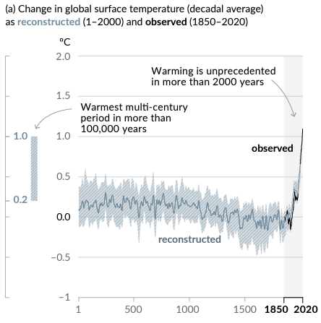
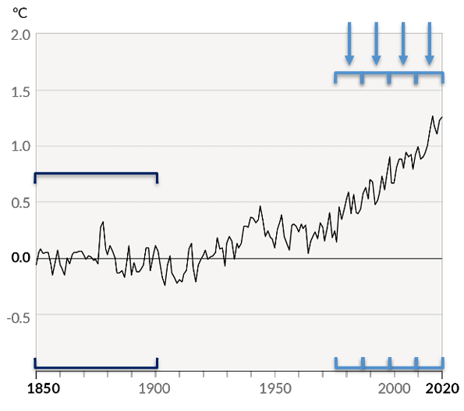
Human Influence & A Warming Planet
IPCC AR6, WG1 2021
Notes:
The rapid changes in these systems are due to human influence. In this graph showing reconstructed climate and observed climate, we can see unprecedented warming in the last 2000 years. Around 1850 (corresponds to the Industrial Revolution), warming substantially increased.
Each of the last four decades has been successively warmer than any decade that preceeded it since 1850.
Global surface temps in the first two decades (2001 – 2020) was nearly 1°C higher than the time period 1850-1900.
Global surface temps were 1.09 °C higher in 2011-2020 than 1850 – 1900. – these changes were larger over land than the ocean

Slide 21
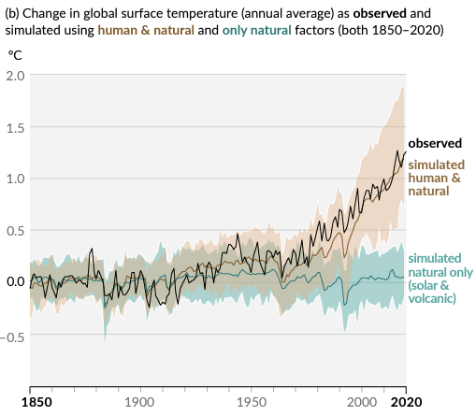
Human Influence & A Warming Planet
2010-2020 was the hottest decade in 125,000 years
IPCC AR6, WG1 2021
Notes:
And, the science now allows us to look more specifically at the human contribution by running models that simulate human and natural contributions to global climate change (so, GHG emissions from human activity and natural sources like solar and volcanic activities). This is shown in brown. We can then compare the change in global surface temperatures in model simulations that *only* include natural sources (solar and volcanic), shown in green.
We can see clearly that humans are driving much of the global surface temperature rise. And, this becomes dramatically apparent around the 1970s, when the two model estimates diverge. We can see that the decade from 2010-2020 was the HOTTEST DECADE IN 125,000 YEAR

Slide 22
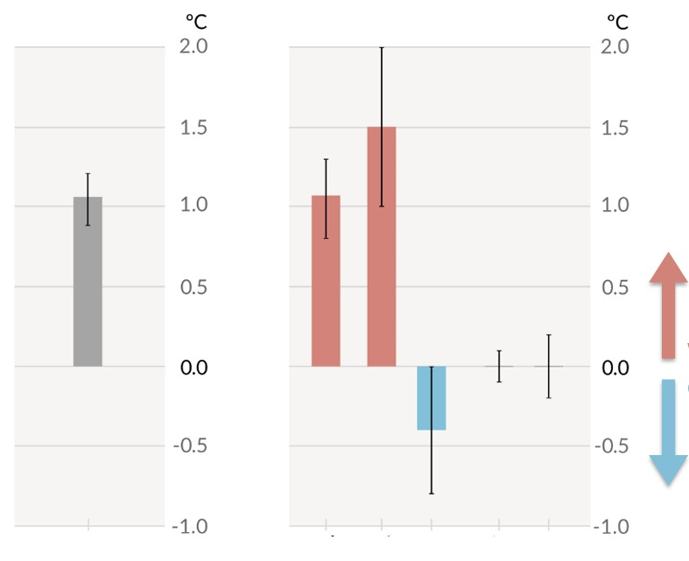
Observed Warming Driven by Greenhouse Gas Emission from Human Activities
Greenhouse Gases
Observed warming is driven by emissions from human activities, with greenhouse gas warming partly masked by aerosol cooling
warming
cooling
Total Human Influence
Observed warming
IPCC AR6, WG1 2021
Pollution Particles (aerosols)
Notes:
Observed warming is driven by emissions from human activities, with greenhouse gas warming partly masked by aerosol cooling
Included in this figure are measures of natural factors (small black vertical bar) and internal variability of the models (larger black bar). However, these are minimal in their contribution to the overall warming and cooling effects we see from human influence and greenhouse gases

Slide 23

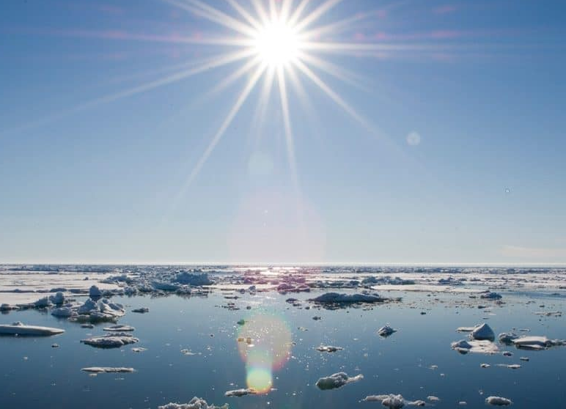
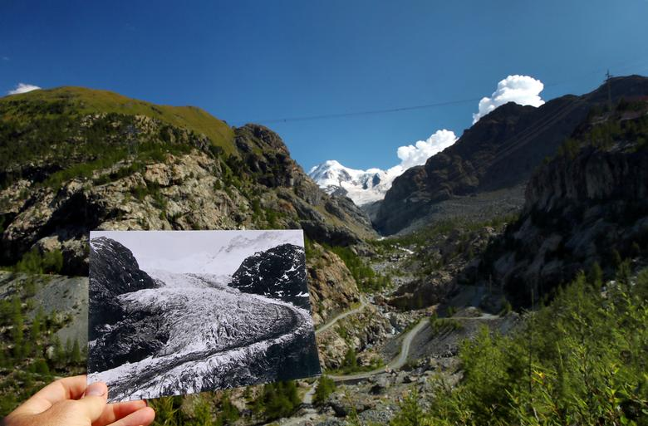
Human Influence as a Main Driver
Heat Extremes
More frequent,
More intense
Ocean Warming
Acidification
Changes in Frozen Areas
Glacial retreat
Arctic sea ice loss
Reduced spring snow
IPCC AR6, WG1 2021
Notes:
The signs of climate change are unequivocal at the global scale and are increasingly apparent on smaller spatial scales. The high northern latitudes show the largest temperature increase, with clear effects on sea ice and glaciers. The warming in the tropical regions is also apparent because the natural year-to-year variations in temperature there are small. Long-term changes in other variables such as rainfall and some weather and climate extremes have also now become apparent in many regions.
Human influence is a main driver of some of the impacts we’re seeing today. In particular, we are seeing:
Extreme heat that is becoming more common – including in parts of the world that didn’t experience extreme heat – and the heat events are more intense. Meaning, the temperatures are getting higher
Since the 1970s, there’s been a well-documented trend in ocean temperatures increasing. This is associated with ocean acidification – where the reduction of seawater pH is a consequence of the oceans absorbing large amounts of CO2.
Changes in the frozen areas of the planet: Specifically
Global retreat of glaciers since the 1990s
40% decrease in Arctic sea ice since 1979
Decrease in spring snow cover since the 1950s

Slide 24
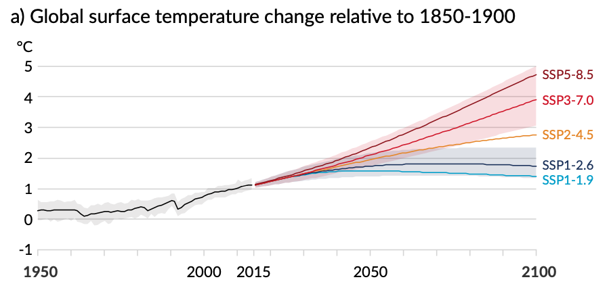
State of Climate Science – AR6
Human influence on global climate is unequivocal.
The scale of recent changes across the climate system is unprecedented.
Evidence of observed changes in extremes has strengthened since AR5 (2013).
Possible Climate Futures
Every world region is projected to increasingly experience concurrent and multiple changes. Even a difference between 1.5ºC and 2ºC can lead to pronounced changes.
Strong, rapid, and sustained reductions in emissions required now.
Changes due to past GHG emissions are irreversible for centuries to millennia.
Fossil-Fueled Development
Sustainable Development
IPCC AR6, WG1 2021
Notes:
Human influence on global climate is unequivocal.
The scale of recent changes across the climate system is unprecedented.
Evidence of observed changes in extremes has strengthened since AR5 (2013).
Every world region is projected to increasingly experience concurrent and multiple changes. Even a difference between 1.5ºC and 2ºC can lead to pronounced changes. Strong, rapid, and sustained reductions in emissions required now.
In response to these impacts, adaptation efforts “have been observed across all sectors and regions, generating multiple benefits”, the authors say, but this progress is “unevenly distributed” as well as being “fragmented, small in scale [and] incremental”.
Changes due to past GHG emissions are irreversible for centuries to millennia.

Slide 25
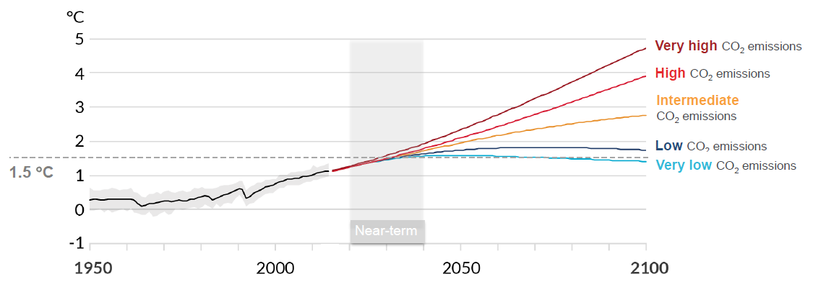
Future Emissions → Future Additional Warming
At current rate, we're on track to reach the CO₂ production limits set at the 2015 Paris Climate Accords in fewer than 10 years.
IPCC AR6, WG1 2021
Notes:
If the world does not begin to rapidly reduce emissions, it is clear that the 1.5C target will be passed sometime between 2026 and 2042.

Slide 26
“Unless there are immediate, rapid, and large-scale reductions in greenhouse gas emissions, limited warming to 1.5 C will be beyond reach”
Notes:
Deliberate removal of carbon dioxide (CO2) from the atmosphere could reverse (i.e. change the direction of) some aspects of climate change. However, this will only happen if it results in a net reduction in the total amount of CO2 in the atmosphere, that is, if deliberate removals are larger than emissions. Some climate change trends, such as the increase in global surface temperature, would start to reverse within a few years. Other aspects of climate change would take decades (e.g., permafrost thawing) or centuries (e.g., acidification of the deep ocean) to reverse, and some, such as sea level rise, would take centuries to millennia to change direction

Slide 27
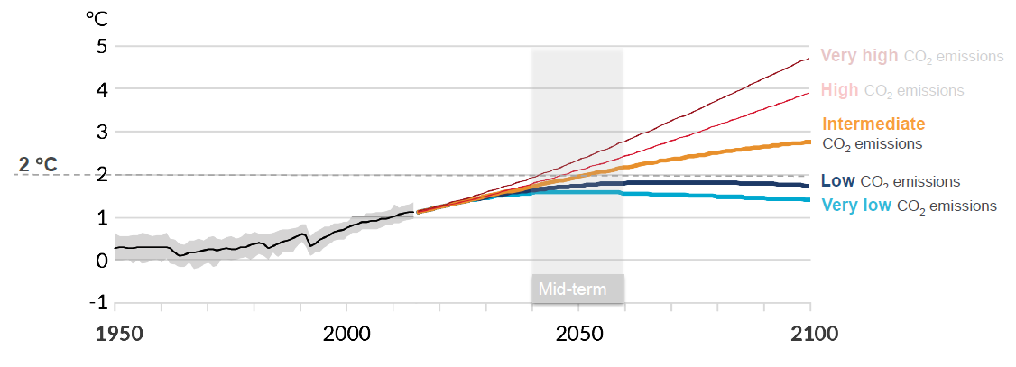
Future Emissions → Future Additional Warming
IPCC AR6, WG1 2021
Notes:
In order to limit our warming to 2C before 2100, we would need net-zero commitments
If emissions continue to increase, global warming could exceed 2C between the 2030s and 2050s.

Slide 28
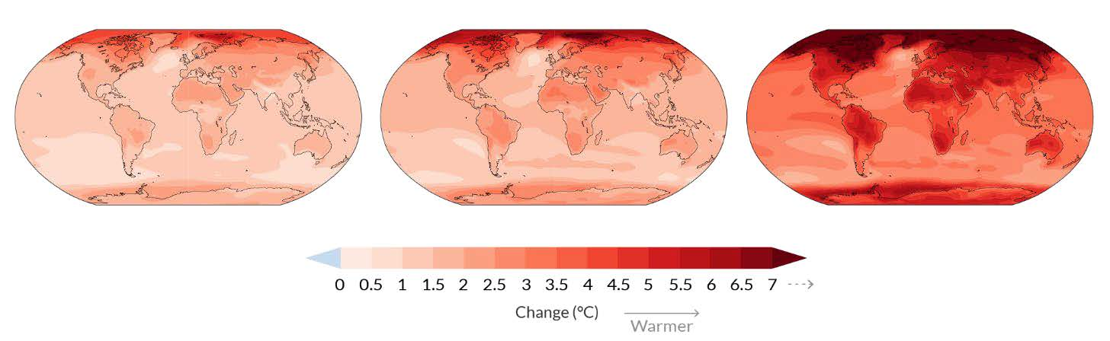
Temperature Annual Mean Temperature Change (°C) relative to 1850-1900
With every increment of global warming, regional mean changes get larger
1.5°C
2°C
4°C
IPCC AR6, WG1 2021
Notes:
With every increment of global warming, changes get larger in regional mean temperature, precipitation, and soil moisture. Let’s look here at temperature.
Warming at 1ºC affects all continents and is generally larger over land than over the oceans in both observations and models.
We see three simulated changes: 1.5ºC, 2ºC, and 4ºC. Across warming levels, *land areas* warm more than ocean areas, and the Arctic and Antarctica warm more than tropics.

Slide 29
Precipitation Annual Mean Precipitation Change (%) relative to 1850-1990
With every increment of global warming, regional mean changes get larger
1.5°C
2°C
4°C
IPCC AR6, WG1 2021
Notes:
Here, we have similar simulations, but looking at annual mean changes in precipitation.
Precipitation is projected to increase over high latitudes, the equatorial Pacific, and parts of the monsoon regions, but decrease over parts of the subtropics and in limited areas of the tropics.

Slide 30
Soil Moisture Annual Mean Total Column Soil Moisture Change (std. dev.)
With every increment of global warming, regional mean changes get larger
1.5°C
2°C
4°C
IPCC AR6, WG1 2021
Notes:
Lastly, we look at soil moisture. Soil moisture is important because it is one of the indicators of drought. We see across warming levels, changes in soil moisture largely follow changes in precipitation but also show some differences due to the influence of evapotranspiration (where water moves from the earth’s surface into the atmosphere)

Slide 31
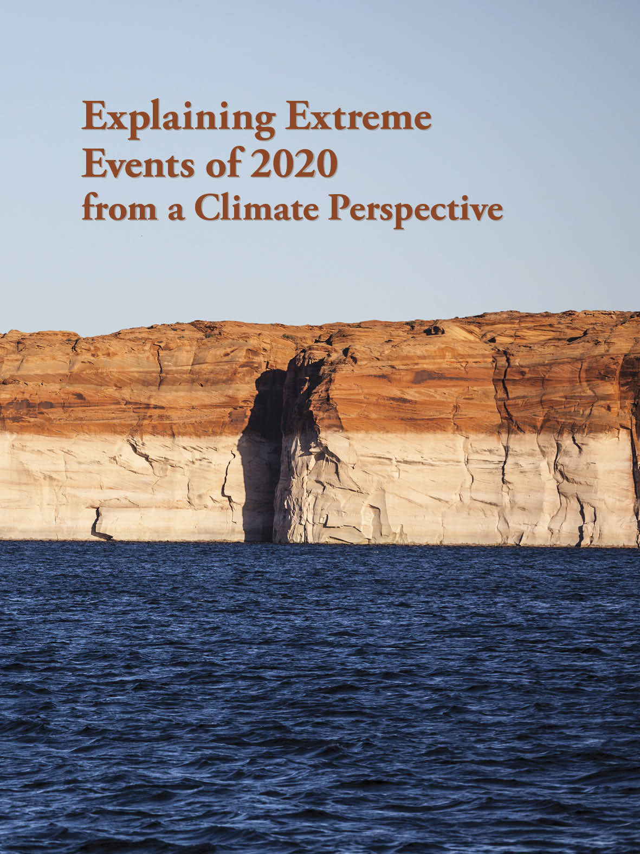
Extreme Event Attribution
Reframing the Question
“Has climate change altered the likelihood of an extreme event happening?”
Bulletin of the American Meteorological Society
Vol. 102. No 1 January 2022
Notes:
Why we’re interested in how attribution can be integrated models;
This BAMS special report presents assessments of how human-caused climate change may have affected the strength and likelihood of individual extreme events.
Attribution statements are provided when the studies are available in the scientific publications. Not being mentioned does not mean that the change is not attributable to climate change

Slide 32

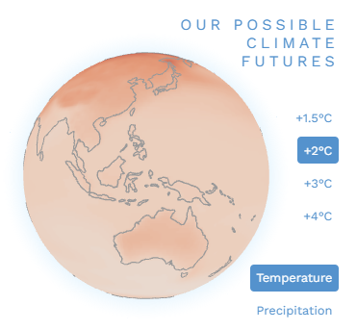

IPCC Working Group 1 Interactive Atlas
Regional Information
Regional
Synthesis
Bulletin of the American Meteorological Society
Vol. 102. No 1 January 2022
Notes:
The Interactive Atlas has two components.
The first (regional information) includes the ability to generate global maps and a number of regionally aggregated products (time series, scatter plots, tables, climate stripes, etc.) for observed and projected climate change for time periods, emissions scenarios or global warming levels of interest. It integrates a range of different datasets, including global and regional observations and the three most recent coordinated global and regional climate projection experiments: CMIP5, CORDEX and CMIP6, for different key variables, extreme indices and climatic impact-drivers (CIDs).
The second component (regional synthesis) provides qualitative information about changes in climatic impact-drivers (CIDs) in several categories such as heat and cold, wet and dry, or coastal and oceanic. Users can select one or several impact-drivers and visualize the regional historical trends and projected changes over the sub-continental reference regions.
One thing that is particularly useful about the IPCC Atlas is that it demonstrates what happens if humans (i.e., governments) fail to cut carbon emissions

Slide 33
ONE HEALTH WORKFORCE ACADEMIES
Thank you for completing Lesson 1: The Science of Global Climate Change
One Health Certificate Course

