Slide 1
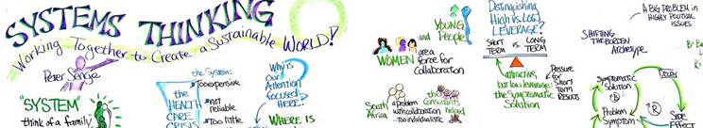


Systems thinking, One Health Course

Slide 2
Module Overview:
Problem-Based Learning
Systems thinking, One Health Course

Slide 3
MODULE COMPETENCIES
Competency #1
  Describe the elements of complex problems and systems thinking
Competency #2
  Create and use systems mapping to deepen understanding of OH problems
Competency #3
  Partner with OH team members to develop solutions to complex OH problems using systems thinking and tools

Slide 4
Module overview
Time | Topic
30 minutes | Introduction
60 minutes | What is Systems Thinking: The Learning Challenge
180 minutes | What is Systems Thinking: The Exploration
60 minutes | What is Systems Thinking: Sharing the Learning
90 minutes | Wicked Problems: Finding Solutions to One Health Problems through Systems Thinking
60 minutes | Wicked One Health Problems: Sharing the Learning
30 minutes | Evaluation

Slide 5
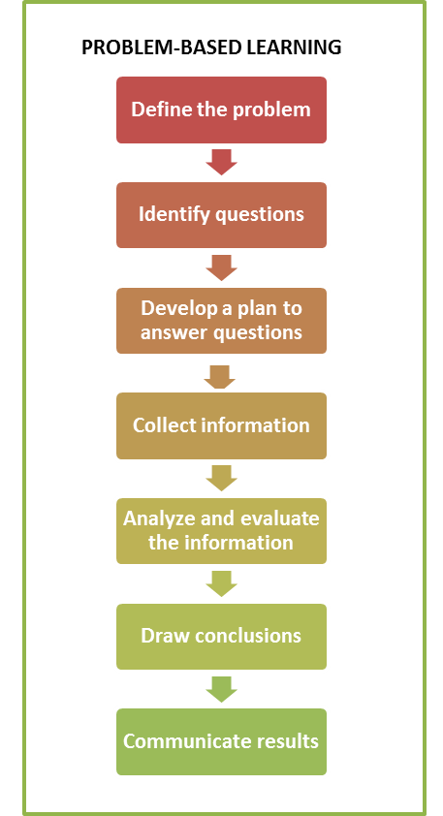

Slide 6


Slide 7
What is Systems Thinking: The Learning Challenge
Systems thinking, One Health Course

Slide 9
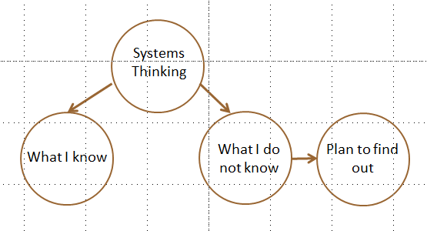

Slide 10
Create a learning plan
Things we know about systems thinking | Things we do not know about systems thinking | Plan for learning more about what we do not know

Slide 11
As a team, think about…
What do you need to know about systems thinking in order to use a systems thinking approach in addressing One Health problems?
In what order should you research the items identified in the previous question?
What are the primary resources that you will use?
What will you do when you cannot find the information that you want?
What will you do when you have questions?
How will you know when you have enough information?

Slide 12
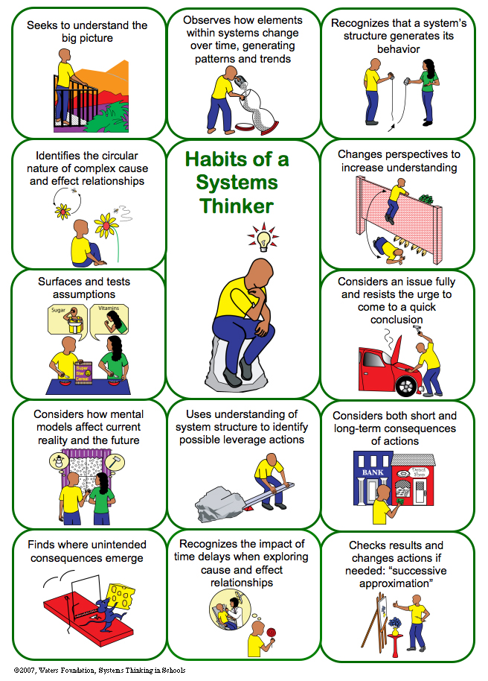

Slide 13
What is Systems Thinking: The Exploration
Systems thinking, One Health Course

Slide 14
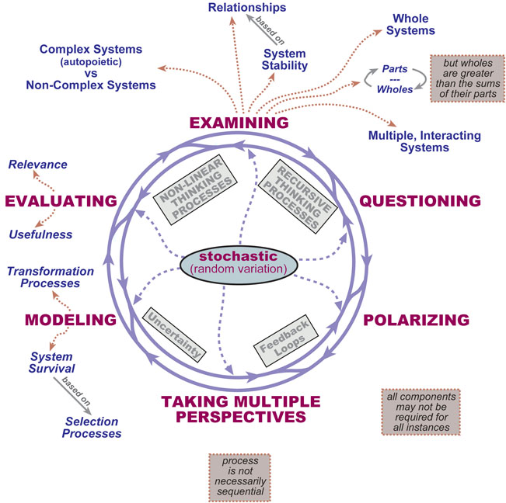

Slide 15
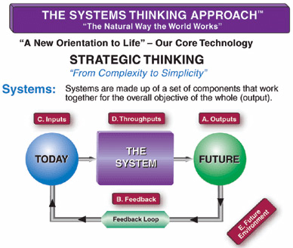

Slide 16
Wicked Problems:
Finding Solutions to One Health Problems through Systems Thinking
Systems thinking, One Health Course

Slide 17
OH Challenge
SYSTEMS THINKING

Slide 18
OH Challenge
Who
Who has the disease
Who is impacted by the disease?
Who are the responders?
Who are other stakeholders?
SYSTEMS THINKING

Slide 19
OH Challenge
Who
Where
Who has the disease
Who is impacted by the disease?
Who are the responders?
Who are other stakeholders?
Where was the first case?
Where has it spread?
SYSTEMS THINKING

Slide 20
Who has the disease
Who is impacted by the disease?
Who are the responders?
Who are other stakeholders?
OH Challenge
Who
Where
When
When was the first case?
How quickly is it spreading?
Where was the first case?
Where has it spread?
SYSTEMS THINKING

Slide 21
OH Challenge
Who
Where
When
How
Who has the disease
Who is impacted by the disease?
Who are the responders?
Who are other stakeholders?
Where was the first case?
Where has it spread?
How is the disease transmitted?
How serious is it?
How can it be managed or controlled?
When was the first case?
How quickly is it spreading?
SYSTEMS THINKING

Slide 22
Who has the disease
Who is impacted by the disease?
Who are the responders?
Who are other stakeholders?
What are the implications for human health?
Animal health?
Ecological health?
OH Challenge
Who
Where
When
How
What
Where was the first case?
Where has it spread?
How is the disease transmitted?
How serious is it?
How can it be managed or controlled?
When was the first case?
How quickly is it spreading?
SYSTEMS THINKING

Slide 23
Who has the disease
Who is impacted by the disease?
Who are the responders?
Who are other stakeholders?
OH Challenge
Who
Where
When
How
What
Why
Why did the outbreak occur?
What are the implications for human health?
Animal health?
Ecological health?
Where was the first case?
Where has it spread?
How is the disease transmitted?
How serious is it?
How can it be managed or controlled?
When was the first case?
How quickly is it spreading?
SYSTEMS THINKING

Slide 24
What is a Wicked Problem?
Systems thinking, One Health Course

Slide 25

Notes:
No narration. Show slide and move to the next slide.

Slide 26
WICKED PROBLEMS
Notes:
No narration. Show slide and move to the next slide.

Slide 27
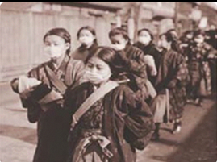
Notes:
No narration. Show slide and move to the next slide.

Slide 28
WICKED PROBLEMS
Notes:
No narration. Show slide and move to the next slide.

Slide 29
One thing..
That you liked/felt was a strength of the module.
That you would suggest we change.

Slide 30
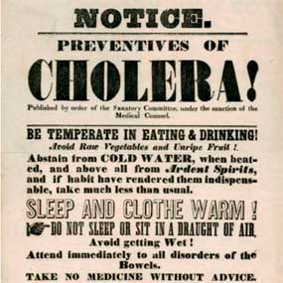
Notes:
No narration. Show slide and move to the next slide.

Slide 31
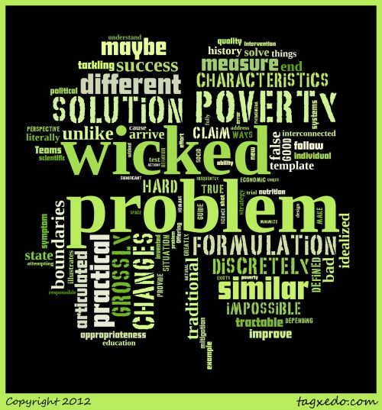
Notes:
Define wicked problems: Simple put, a complex problem for which there is no simple method of solution. Wicked problems tend to be a social or cultural problems that are difficult or impossible to solve for as many as four reasons: incomplete or contradictory knowledge, the number of people and opinions involved, the large economic burden, and the interconnected nature of these problems with other problems.
Emerging pandemic threats are WICKED PROBLEMS.

Slide 32
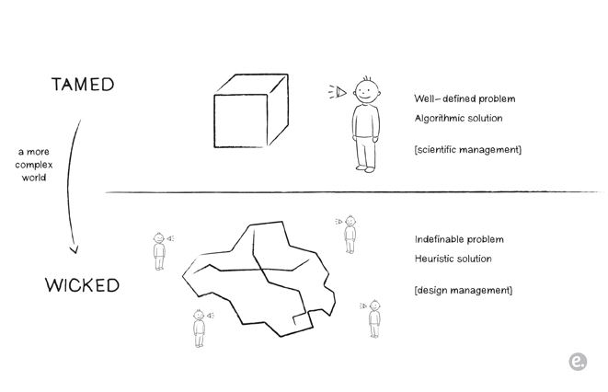
http://www.co-society.com/2010/11/wicked-problems/
Notes:
Contrasting the easier (tamed) problems against the harder wicked problems.

Slide 33
WICKED
PROBLEMS
DIFFICULT
TO DEFINE
INTER-DEPEN
DENCIES
AND
MULTI-CAUSAL
SOLUTIONS CAN
LEAD TO
UNFORESEEN
CONSEQUENCES
NO CLEAR
SOLUTION
SOCIALLY
COMPLEX
INVOLVE
CHANGING
BEHAVIOR
CROSS
ORGANIZATIONAL
BOUNDARIES
AND
RESPONSIBILITIES
PROBLEMATIC
DUE TO
WEAK
POLICIES
Notes:
Horst Rittel, one of the first to formalize a theory of wicked problems, cites ten characteristics of these complicated social issues Rittel, Horst. "Dilemmas in a General Theory of Planning." Policy Sciences, 1973: 155-169.:
Wicked problems have no definitive formulation. The problem of poverty in Texas is grossly similar but discretely different from poverty in Nairobi, so no practical characteristics describe "poverty."
It's hard, maybe impossible, to measure or claim success with wicked problems because they bleed into one another, unlike the boundaries of traditional design problems that can be articulated or defined.
Solutions to wicked problems can be only good or bad, not true or false. There is no idealized end state to arrive at, and so approaches to wicked problems should be tractable ways to improve a situation rather than solve it.
There is no template to follow when tackling a wicked problem, although history may provide a guide. Teams that approach wicked problems must literally make things up as they go along.
There is always more than one explanation for a wicked problem, with the appropriateness of the explanation depending greatly on the individual perspective of the designer.
Every wicked problem is a symptom of another problem. The interconnected quality of socio-economic political systems illustrates how, for example, a change in education will cause new behavior in nutrition.
No mitigation strategy for a wicked problem has a definitive scientific test because humans invented wicked problems and science exists to understand natural phenomena.
Offering a "solution" to a wicked problem frequently is a "one shot" design effort because a significant intervention changes the design space enough to minimize the ability for trial and error.
Every wicked problem is unique.
Designers attempting to address a wicked problem must be fully responsible for their actions.
https://www.wickedproblems.com/1_wicked_problems.php

Slide 34
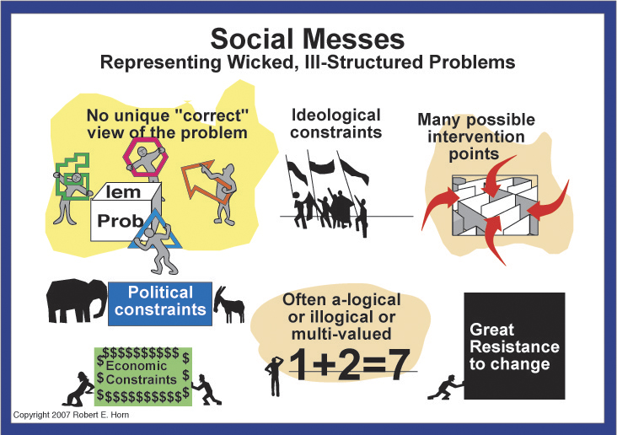
http://robertweber.typepad.com/photos/uncategorized/2007/09/22/1representmesses.jpg
Notes:
In working with “wicked problems,” Robert Horn coined the phrase “social messes” and defined a social mess as a set of interrelated problems involving complexity – system of systems – that are resistant to analysis and resolution.
Horn cited 15 defining characteristics of a social mess. (Review information on this slide and the following slide.)

Slide 35
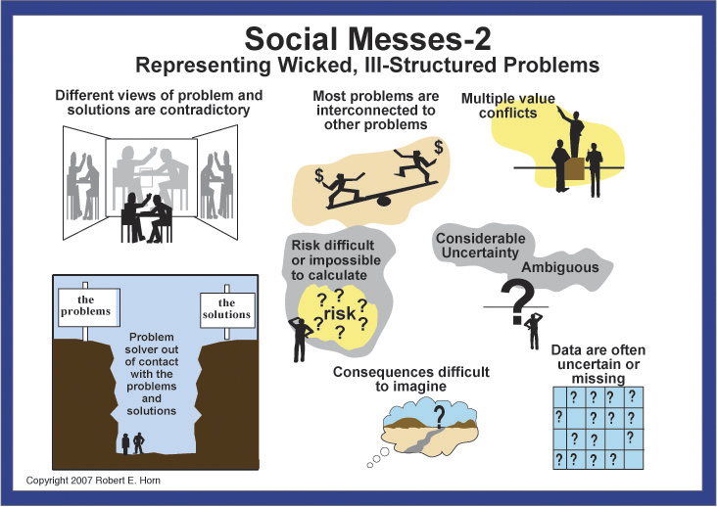
http://robertweber.typepad.com/photos/uncategorized/2007/09/22/2represenmesses_3.jpg

Slide 36
“If everyone is thinking alike, then somebody isn't thinking.”
    Gen. George S. Patton
Notes:
Read quote.

Slide 37
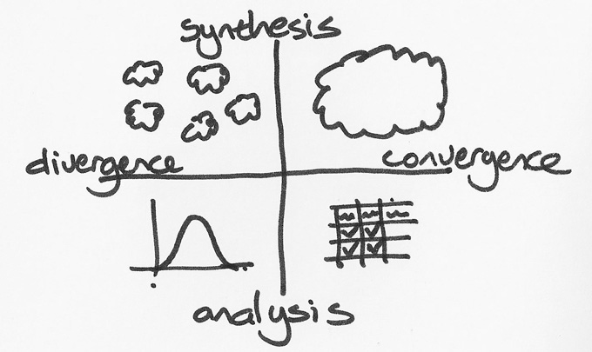
Wicked problems need
multiple kinds of thinking.
http://world.edu/wp-content/uploads/2012/05/divergence.jpg
Notes:
There is no right way to approach a wicked problem…rather it takes multiple ways of thinking, multiple perspectives. That is why One Health brings together a multi-disciplinary team to tackle some of the most complex health problems.

Slide 38

http://www.whattodonext.com.au/on-wicked-problems/

Slide 39
One health Wicked challenges
Challenge 1. There is an outbreak of an influenza-like illness among people and animals in a small town in Thailand. Create a systems map of how you would respond to the outbreak boundary conditions.
Challenge 2. Fifty (50) chickens die before the TET holiday in one village in Vietnam.
Challenge 3. Three come to the health station showing signs and symptoms of dengue fever in a small town in Indonesia.

Slide 40
Wicked Problems: Sharing Solutions
Systems thinking, One Health Course

Slide 41
Module Review
Systems thinking, One Health Course

Slide 42
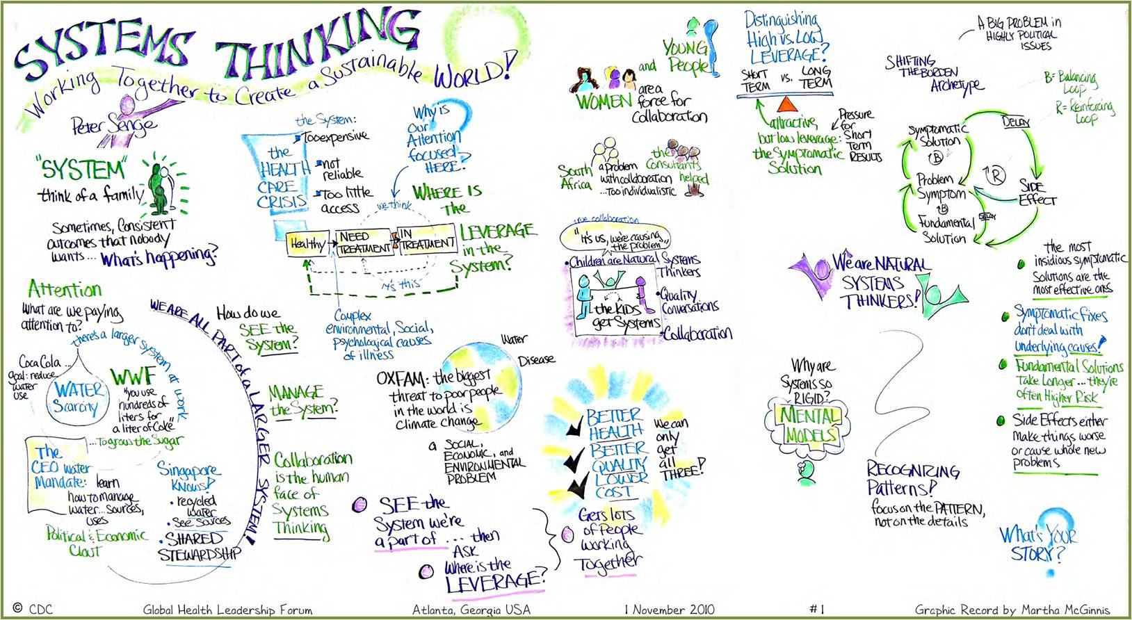
Systems Thinking on Systems Thinking
http://library.tephinet.org/sites/default/files/st_visual_recording_0.jpg

