Slide 1
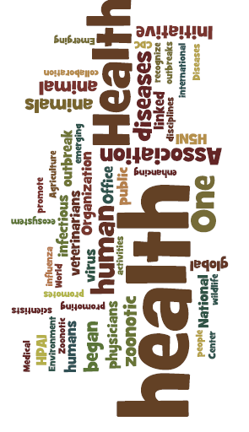


One health concepts and knowledge,
One Health Course

Slide 2
One Health Knowledge
One health concepts and knowledge,
One Health Course

Slide 3
Module competencies
Competency #1
  Explain the history and concept of One Health.
Competency #2
  Describe the One Health Core Competency Domains and their application.
Competency #3
  Describe the application of the One Health approach.

Slide 4
Module overview
Time/Length | Topic/Activity
90 Minutes | One Health Knowledge
70 Minutes | Who Might be on a One Health Team?
60 Minutes | One Health Core Competency Domains
65 Minutes | The “Approach-Discipline” Debate
120 Minutes | One Health in Action
60 Minutes | Learning Reflections and Evaluation

Slide 5
How would you define…
ONE HEALTH

Slide 6
Why one health
Why now... | As a result…

Slide 7
Why one health
Why now... | As a result…
Human populations are growing and expanding into new geographic areas.

Slide 8
Why one health
Why now... | As a result…
Human populations are growing and expanding into new geographic areas. | More people live in close contact with wild and domestic animals. Close contact provides more opportunities for diseases to pass between animals and people.

Slide 9
Why one health
Why now... | As a result…
Human populations are growing and expanding into new geographic areas. | More people live in close contact with wild and domestic animals. Close contact provides more opportunities for diseases to pass between animals and people.
The earth has experienced changes in climate and land use, such as deforestation and intensive farming practices.

Slide 10
Why one health
Why now... | As a result…
Human populations are growing and expanding into new geographic areas. | More people live in close contact with wild and domestic animals. Close contact provides more opportunities for diseases to pass between animals and people.
The earth has experienced changes in climate and land use, such as deforestation and intensive farming practices. | Disruptions in environmental conditions and habits provide new opportunities for diseases to pass to animals.

Slide 11
Why one health
Why now... | As a result…
Human populations are growing and expanding into new geographic areas. | More people live in close contact with wild and domestic animals. Close contact provides more opportunities for diseases to pass between animals and people.
The earth has experienced changes in climate and land use, such as deforestation and intensive farming practices. | Disruptions in environmental conditions and habits provide new opportunities for diseases to pass to animals.
International travel and trade have increased.

Slide 12
Why one health
Why now... | As a result…
Human populations are growing and expanding into new geographic areas. | More people live in close contact with wild and domestic animals. Close contact provides more opportunities for diseases to pass between animals and people.
The earth has experienced changes in climate and land use, such as deforestation and intensive farming practices. | Disruptions in environmental conditions and habits provide new opportunities for diseases to pass to animals.
International travel and trade have increased. | Diseases can spread quickly across the globe.

Slide 13
History of One health

Slide 14

Hippocrates c. 460 BCE – c. 370 BCE

Slide 15
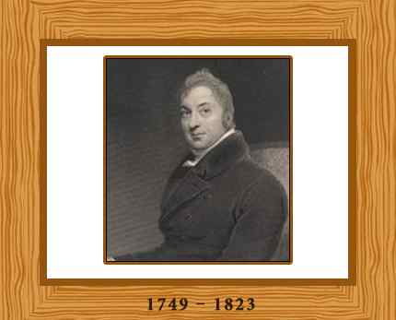




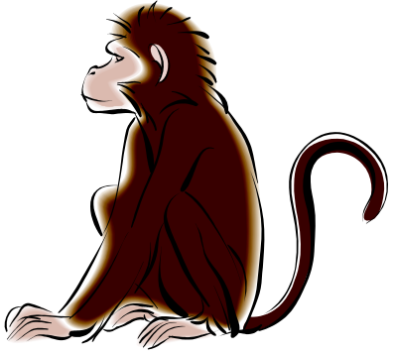
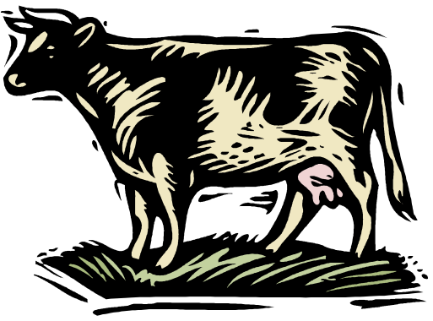


One Health History
Edward Jenner found that milkmaids exposed to cowpox that were not infected with smallpox.
From this discovery, produced first successful vaccine to prevent smallpox.
E. Jenner, first using dead vaccine to prevent hog cholera – open the way to produce vaccine to prevent Rickettsia and Polio diseases in man.
Sir Edward Jenner
Source: Patricia at al., 2009
Một Sức Khỏe?
Notes:
Đây là định nghĩa trong khung chiến lược để giảm thiểu nguy cơ các bệnh truyền nhiễm giữa động vật-con người-hệ sinh thái đã được phát triển tại hội nghị các bộ trưởng thế giới về các bệnh truyền nhiễm tại Sharmel Sheikh, tháng 10, 2008 và được chấp nhận rộng rãi hiện nay.
Một Sức Khỏe không phải là một chương trình mà là một cách tiếp cận

Slide 16
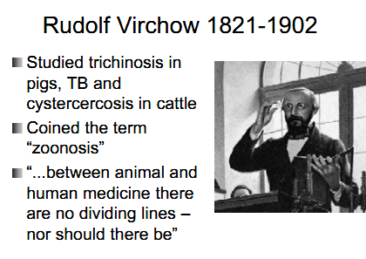
One Health History (continued)
Source: Laura H. Kahn, 2011

Slide 17
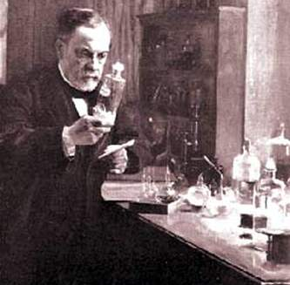
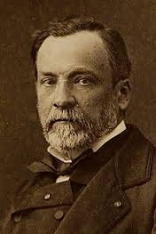
One Health History (continued)
Sir Louis Pasteur – French
Respected as father of Immunology
Produced vaccine to prevent rabies
Linked medicine and veterinary medicine.
Sir Louis Pasteur
(1822-1895)
Source: Patricia and et al, 2009
Một Sức Khỏe?
Notes:
Đây là định nghĩa trong khung chiến lược để giảm thiểu nguy cơ các bệnh truyền nhiễm giữa động vật-con người-hệ sinh thái đã được phát triển tại hội nghị các bộ trưởng thế giới về các bệnh truyền nhiễm tại Sharmel Sheikh, tháng 10, 2008 và được chấp nhận rộng rãi hiện nay.
Một Sức Khỏe không phải là một chương trình mà là một cách tiếp cận

Slide 18
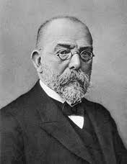
One Health History (continued)
Sir Robert Koch, German physician.
Established the field of bacteria.
Excellent studied on TB, Vibriocholerae, anthrax.
Nobel in medicine.
Linked medicine with vet. medicine, especially study on Bacilus anthacis.
Sir Robert Koch
(1843-1910)
Source: Patricia and et al, 2009
Một Sức Khỏe?
Notes:
Một Sức Khỏe không phải là một chương trình mà là một cách tiếp cận

Slide 19
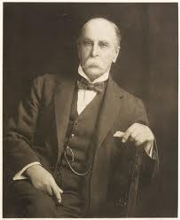
One Health History (continued)
Sir William Osler, Canadian physician
1873 went to Germany, student of Robert Wirchow.
Established the field of vet. pathology as an academic disciplinary in North American.
Sir W. Osler was first to use: “One Medicine” in literature
Sir William Osler (1849-1919)
Source: Patricia and et al, 2009
Một Sức Khỏe?
Notes:
Đây là định nghĩa trong khung chiến lược để giảm thiểu nguy cơ các bệnh truyền nhiễm giữa động vật-con người-hệ sinh thái đã được phát triển tại hội nghị các bộ trưởng thế giới về các bệnh truyền nhiễm tại Sharmel Sheikh, tháng 10, 2008 và được chấp nhận rộng rãi hiện nay.
Một Sức Khỏe không phải là một chương trình mà là một cách tiếp cận

Slide 20
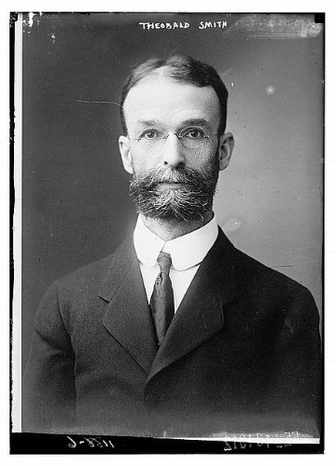
One Health History (continued)
Theobald Smith and F.L. Kilbourne first discovered arthropode play a role vector (1893)
Demonstrated Boophilus transmission Babesia bigemina parasite caused disease in cattle
Based on this discovery, Walter Reed found the vector of Yellow fever.
Sir Theobald Smith
(1859-1934)
Source: Patricia et al., 2009
Một Sức Khỏe?
Notes:
Đây là định nghĩa trong khung chiến lược để giảm thiểu nguy cơ các bệnh truyền nhiễm giữa động vật-con người-hệ sinh thái đã được phát triển tại hội nghị các bộ trưởng thế giới về các bệnh truyền nhiễm tại Sharmel Sheikh, tháng 10, 2008 và được chấp nhận rộng rãi hiện nay.
Một Sức Khỏe không phải là một chương trình mà là một cách tiếp cận

Slide 21
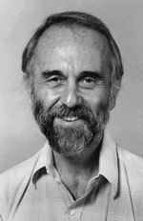
One Health History (continued)
Best known along with Jame H. Steele as one of the founders of the disciplinary of veterinary epidemiology and the concept of One Medicine-One Health
Sir Calvin Schwabe (1927-2006)
Source: CDC, 2011
Một Sức Khỏe?
Notes:
Đây là định nghĩa trong khung chiến lược để giảm thiểu nguy cơ các bệnh truyền nhiễm giữa động vật-con người-hệ sinh thái đã được phát triển tại hội nghị các bộ trưởng thế giới về các bệnh truyền nhiễm tại Sharmel Sheikh, tháng 10, 2008 và được chấp nhận rộng rãi hiện nay.
Một Sức Khỏe không phải là một chương trình mà là một cách tiếp cận

Slide 22
Definitions and concepts

Slide 23
Definitions
Directions:
Conduct an internet search looking for definitions of the following terms.
  Ecohealth
  Ecosystems Health
  Global Health
  One Health
  Environmental Health
As you conduct the search, write down local, regional and international organizations youcome across.

Slide 24
Definitions of One Health
The One Health concept is a worldwide strategy for expanding interdisciplinary collaborations and communications in all aspects of health care for humans, animals and the environment. The synergism achieved will advance health care for the 21st century and beyond by accelerating biomedical research discoveries, enhancing public health efficacy, expeditiously expanding the scientific knowledge base, and improving medical education and clinical care. When properly implemented, it will help protect and save untold millions of lives in our present and future generations.
http://www.onehealthinitiative.com/about.php

Slide 25
Definitions of One Health (continued)
The One Health concept recognizes that the health of humans is connected to the health of animals and the environment.
CDC uses a One Health approach by working with physicians, ecologists, and veterinarians to monitor and control public health threats. We do this by learning about how diseases spread among people, animals, and the environment.
http://www.cdc.gov/onehealth/

Slide 26

The One Health Concept
“One Health (formerly called One Medicine) is dedicated to improving the lives of all species—human and animal—through the integration of human medicine, veterinary medicine and environmental science.”
Source: www.onehealththiniative.com

Slide 27
Organizations working on one health
World Health Organization (WHO)
Food and Agriculture Organization (FAO)
World Organization for Animal Health (OIE)
One Health Initiative
US Centers for Disease Control
EcoHealth Alliance

Slide 28
seaohun
South East Asia One Health University Network (SEAOHUN) – includes the following four national networks -
Indonesia One Health University Network (INDOHUN)
Malaysia One Health University Network (MyOHUN)
Thailand One Health University Network (THOHUN)
Vietnam One Health University Network (VOHUN)

Slide 29
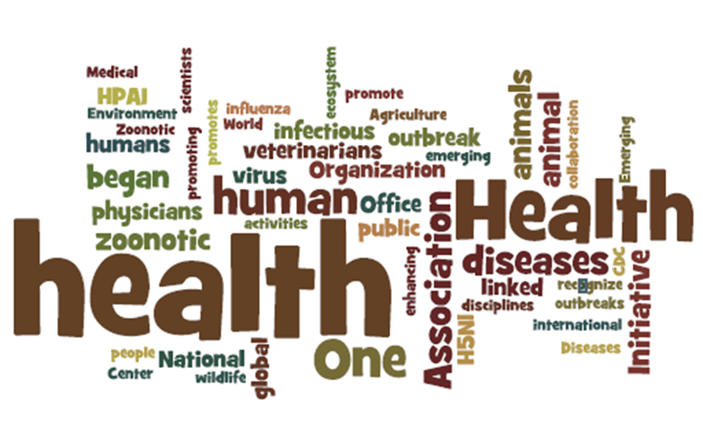

Slide 30
Who Might Be on a
One Health Team?
One health concepts and knowledge,
One Health Course

Slide 31
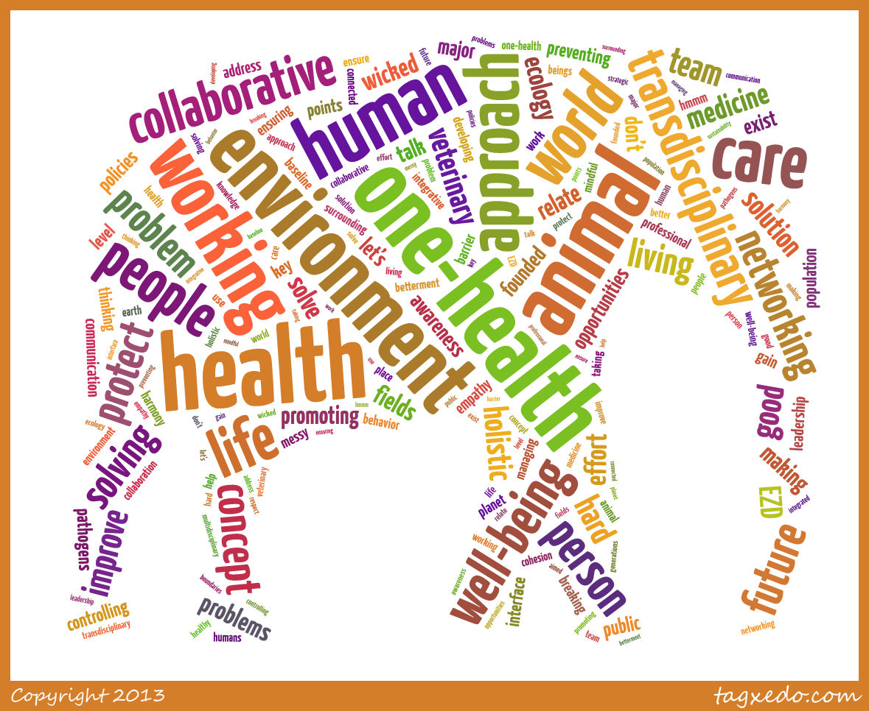

Slide 32
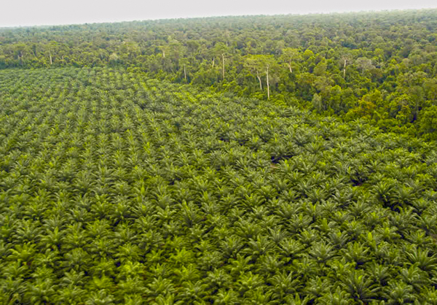
DEFORESTATION AND MALARIA: Who should be on the One Health Team?
Source: climatetasmania.com.au

Slide 33
Possible members of a one health team
Veterinarian
Physician
Nurse
Public Health Worker
Epidemiologist
Wildlife Scientists
Local Leader/Politician
Environmental Health Worker
Ecologist
Social Scientist
Economist
Communications Specialist
Emergency Responder
Laboratorian
Pharmacist
Logistician
Public Affairs/Marketing
Information Technologist

Slide 34
One Health Core
Competency Domains
One health concepts and knowledge,
One Health Course

Slide 36

Jeopardy Clip
http://www.youtube.com/watch?v=XRheqRCv2FA

Slide 37
Switch to Jeopardy PowerPoint Slides

Slide 38
Is One Health
An Approach or a Discipline/Field?
One health concepts and knowledge,
One Health Course

Slide 39

DEBATE: Is One Health a
Discipline or an Approach
20 minutes to prepare
20 minutes to debate

Slide 40
Parliamentary Debate rules
Group A will give its preliminary argument (10 Minutes)
Group B may interject at any time during or directly after the presentation to give their rebuttal. They can only interject once.
Group B will give its preliminary argument (10 Minutes
The rules for the rebuttal from Group A are the same as outlined for Group B.

Slide 41
One Health in Action
My Problem is Real
One health concepts and knowledge,
One Health Course

Slide 42
The Problem
There has been an outbreak of Nipah virus in Lukut, Port Dickson, Malaysia. A group of people have to be identified to discuss response and solutions to the problems created by the outbreak. The meeting will be held at the Ministry of Health and chaired by an official from the Ministry of Health.

Slide 43
Stakeholder meeting:
Roles & responsibilities
Chairperson
Secretary
Stakeholders

Slide 44
Stakeholder meeting: Agenda
First fifteen minutes:
Problems created by the outbreak
Possible solutions
Challenges the team will face
Next forty-five minutes
Rank the problems

Slide 45
What do you think?
What are the challenges faced by the stakeholders?
What stakeholders were not at the meeting?
What might be the challenges those stakeholders face?
How might those stakeholders interact with those who attended the meeting?

Slide 46
Module Review
One health concepts and knowledge,
One Health Course

Slide 47
One thing..
That you liked and felt was a strength of the module.
That you would suggest we change (delete, alter or add)
Thank you.

Slide 48
This publication was made possible in part through the support provided by the United States Agency for International Development. The opinions expressed herein are those of the author(s) and do not necessarily reflect the views of the US Agency for International Development or the US Government. USAID reserves a royalty-free nonexclusive and irrevocable right to reproduce, publish, or otherwise use, and to authorize others to use the work for Government purposes.

