Slide 1

Infectious Disease management
One Health Course
Source: www.curremd.com

Slide 2
Introduction to
Infectious Disease Management
Infectious disease management,
one health course

Slide 3
Competencies
Competency #1
  Identify and analyze risk factors during an infectious disease outbreak
Competency #2
  Design an infectious disease management plan
Competency #3
  Evaluate the effectiveness of One Health actions in infectious disease management
Competency #4
  Design a new, or evaluate an existing disease surveillance and monitoring system

Slide 4
Module sessions
Time/Length | Topic
180 Minutes | Module Introduction and Basic Concepts
100 Minutes | Describe Possible Risk Factors for an Infectious Disease during an Outbreak Scenario
180 Minutes | Creating a Conceptual Model to Visualize Risk Factors and Control Points
60-75 Minutes | Risk Assessment
300 Minutes | Collect Community-based Data
150 Minutes | Develop Infectious Disease Public Awareness Materials: Part 1
135-195 Minutes | Develop Infectious Disease Public Awareness Materials: Part 2

Slide 5
Module sessions
Time/Length | Topic
60 80 Minutes | Critique an Infectious Disease Management Plan using a One Health Perspective
80 Minutes | Describe Systemic Effects of an Infectious Disease Management Plan
160 Minutes | Examine an Existing Surveillance System
150 Minutes | Analyze Surveillance Data Using HealthMap
60 Minutes | One Health Team Role-Playing Activity: A Management and Surveillance Plan
60 Minutes | Learning Reflections & Evaluation

Slide 6
Fundamental Concepts for Infectious Disease Management
Infectious disease management
One Health Course

Slide 7
Infectious Disease
Basic concepts

Slide 8
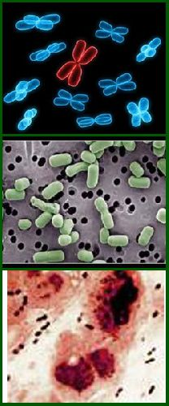
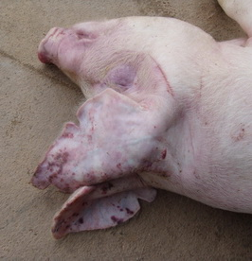
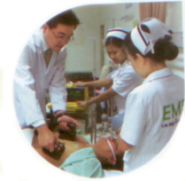
Epidemiological triad
Host
Agent
Environment
Gordis, L. (2004). Epidemiology. Philadelphia: Elsevier Saunders.

Slide 9
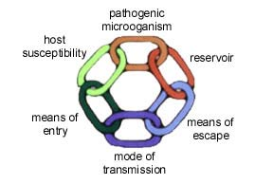
Chain of infection

Slide 10
Managing Infectious DiseaseS
Requires knowledge of:
  Infectious organisms (“agent”)
  Modes of Disease Transmission
  Risk
  Management concepts

Slide 11
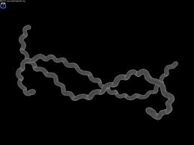
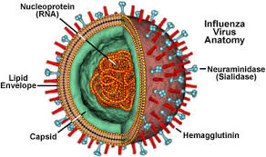
Infectious Organisms
Bacteria
Viruses
Parasites
Fungi
Prions
Leptospira interrogans
en.wikipedia.org
en.wikipedia.org
Notes:
Cover the main categories of infectious organisms and ask students if they can think of a couple of examples of diseases caused by each. A few examples are below, if needed for discussion:
Bacteria: Leptospira interrogans (pictured), Yersinia pestis (causes plague), Borrelia burgdorferi (Lyme disease), E. coli, Salmonella, Campylobacter (all food borne)
Viruses: avian influenza (pictured), SARS, Ebola, Dengue, Japanese encephalitis, Nipah, Hendra
Parasites: malaria (protozoan), roundworms, hookworms, tapeworms (helminths), cryptosporidium (protozoan)
Fungi: Candida albicans, Aspergillus, Histoplasmosis, Cryptococcus, Pneumocystis
Prions: bovine spongiform encephalopathy (mad cow disease), Creutzfeld-Jakob disease, kuru

Slide 12
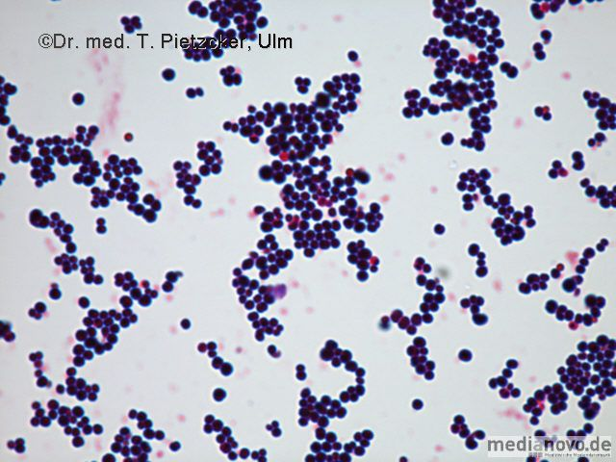
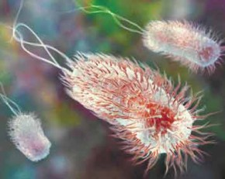
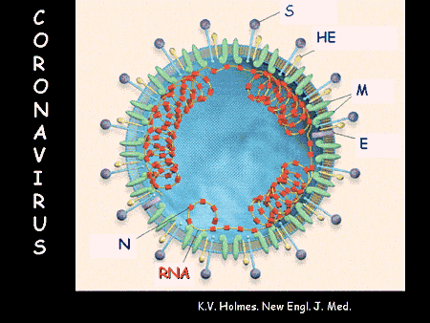
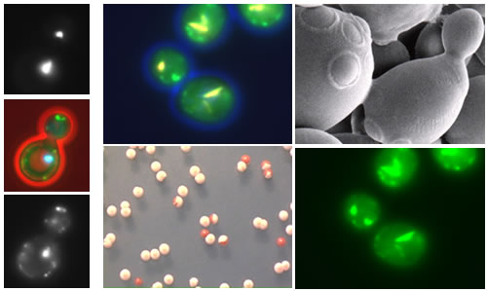
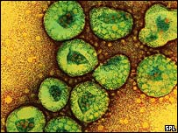
Infectious agents
Clostridium botulinum
Enterohaemorrhagic E. coli O104

Slide 13
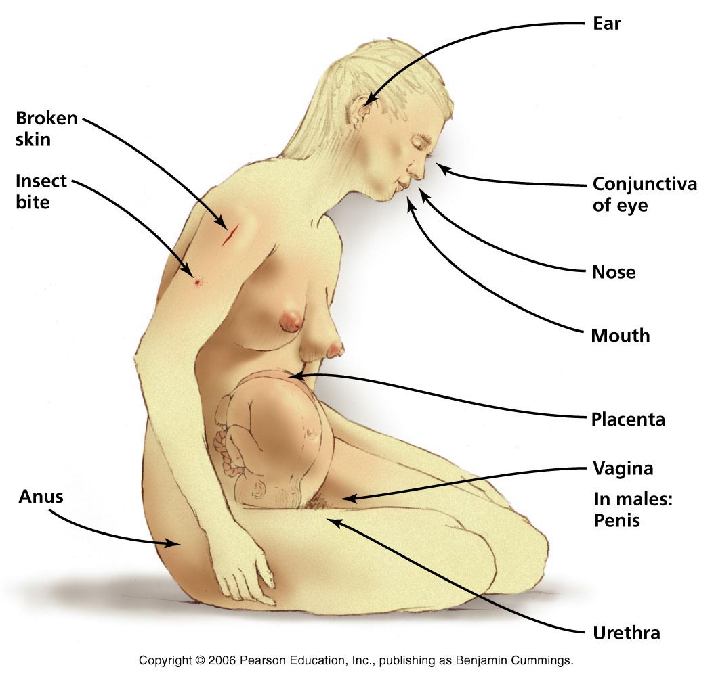
Portal of entry

Slide 14
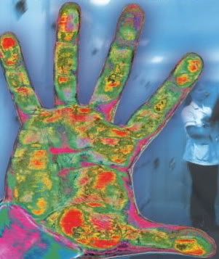
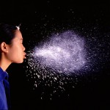
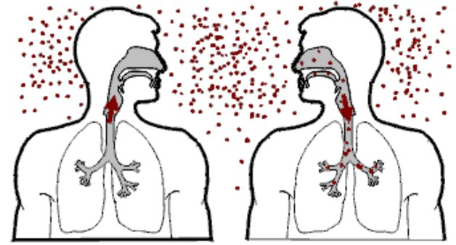

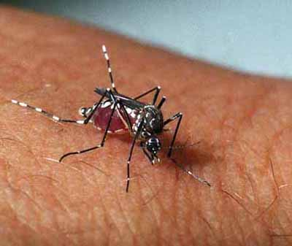

Modes of DISEASE transmission
Contact
  Direct
  Indirect
Airborne
  Droplet
  Airborne
Vector Borne
Vehicle
* Aerosolized Particles
* Aerosolized Particles from coughing or sneezing <5 microns in size containing influenza virus can be inhaled at alveolar level of lungs
Notes:
Transmission – route by which an infectious organism infects a new host
Method of transmission will influence management plan strategies
Transmission routes:
Direct contact with infected animal or human or their secretions
Indirect Contact with a contaminated surface, fomite, or other object
Contact with or consumption of contaminated food or water
Biological vector – bite of an insect such as rats, ticks, mosquitoes, or flies
Ask students for an example of a disease spread by each transmission route. One example of each is below. Note that some diseases can be spread by more than one transmission category – see if students can think of one.
Direct contact – influenza (contact with respiratory secretions of individual – breathing in particles from coughing or sneezing) – influenza could also be spread by fomites
Contaminated surface or fomite – Salmonella on contaminated food prep surface – can also be food consumption
Consumption of food or water – cholera
Biological vector - dengue

Slide 15
Direct Contact Transmission
Direct contact with infected individual person or animals, or their secretions
Infectious organisms can enter via:
  respiratory tract – inhaled particles from sneezing and coughing
  mucous membranes – eyes, nose, reproductive, digestive tracts
  Skin – cuts, wounds, open sore, injury can facilitate entry
  ingestion – swallowing

Slide 16

Contact with Fomite
Fomite: an inanimate object contaminated with an infectious organism
Organisms can survive on surfaces
Does not require direct contact between individuals
Examples of fomites:
  Doorknobs
  computer keyboard
  bedding or towels
  needles, forceps, scissors, other
  medical equipment
  food preparation equipment and
  serving vessels
healthline.com
Notes:
After defining what a fomite is, prompt students to give examples of fomites that may be involved in disease transfer before listing examples.

Slide 17
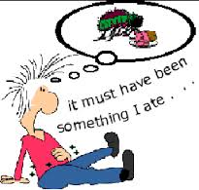
Contaminated Food and Water
Food and water can become contaminated and transmit diseases when consumed
Contaminated food or water possible:
  Restaurants
  Central water supply
  Water storage containers
Often cause gastroenteritis
  Diarrhea, vomiting, nausea
  E. coli, Salmonella, Campylobacter
  Cholera, Hepatitis A
  Intestinal parasites
en.wikipedia.org

Slide 18
Reservoir Hosts & Transmission
Reservoir hosts with infectious agents can transmit the organism, but may not develop disease
Hosts provide a reservoir for the organism in the environment
Management difficult if host population is large or difficult to control
Host may be required for stage(s) of an organism’s development or transmission cycle before capable of infecting another host or vector

Slide 19
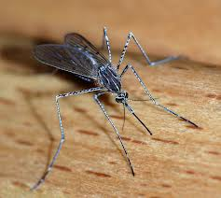
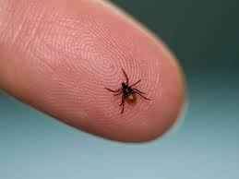
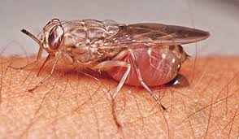
Biological Vectors - ArthropodS
Vector borne diseases common worldwide
Insect provides a necessary part of disease transmission process (e.g, biting during blood meal)
Considering vector(s) key to management plans
www.tse-tse.com
www.cdc.gov
www.list25.com

Slide 20
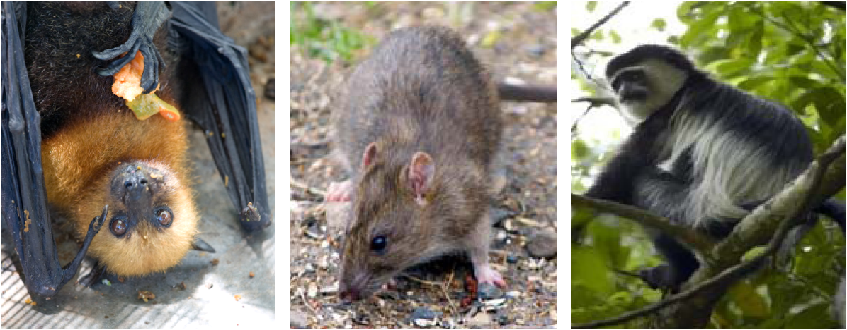
Biological vectors - animals

Slide 21
Risk FACTORS and Infectious Diseases
Consider risk factors when forming a management plan
Risk factors affect whether an individual will contract a disease
Consider intrinsic and extrinsic risk factors
Consider high-risk behaviors / occupations
Knowledge about risk factors useful when developing public awareness materials

Slide 22
Intrinsic Risk Factors
Intrinsic factors are those related to the host itself (human or animal):
Genetics
  May cause susceptibility to a disease
  Host have correct receptors? (important for many viruses)
Immune system – robust response can reduce severity
Underlying diseases (HIV/AIDS, cancer – immunodeficiency associated with increased severity of disease, death)
Age (infants, children, elderly generally more susceptible to severe illness)
Nutrition (malnutrition, or being under- or overweight can increase susceptibility to disease)

Slide 23
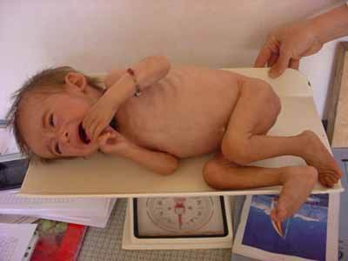
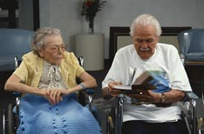
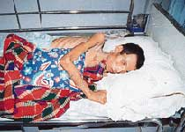
Susceptible hosts
Notes:
Infants, the elderly, and immuno-compromised

Slide 24
Extrinsic Risk Factors
Extrinsic factors are not directly host- related
Reservoir or infectious hosts:
  Does an individual have exposure to infected hosts?
  What are the reservoir hosts?
Exposure risks
  Contaminated food and water
  Contaminated surfaces
  Socioeconomic status

Slide 25
Extrinsic Risk Factors (continued)
Specific temporal risks
  Occupational exposures
  Environmental exposures
  Natural disasters:
    Floods
    Drought
    Climate change

Slide 26
Infectious disease
Management planning

Slide 27
Management Plan:
Fundamental Approach
Need to understand all aspects of disease transmission and risk factors to form an effective infectious disease management plan
Often need to brainstorm and create concept maps with a management team to identify important disease transmission factors
One Health approach – make sure to include members with different backgrounds on your team so important transmission or risk factors are considered (e.g., for zoonotic diseases)

Slide 28
Questions to Guide
Management Plan
What is the infectious organism (agent)?
What are the characteristics of that organism?
Which host species develop disease?
What are the reservoir hosts?
How is the disease transmitted from one host to another?
Who gets the disease?
What are the most important risk factors for disease?

Slide 29
Deciding on a Plan
Determine what interventions are available
  Vaccination
  Treatment
  Control of vectors and reservoir hosts
  Monitoring of food and water supply
  Safe food and water handling and preparation
  Cleaning of contaminated surfaces or fomites
  Animal husbandry practices
  Control of contact with reservoir hosts
  Public education – safe practices related to the disease

Slide 30
Evaluating the Plan
Once possible intervention strategies determined, consider best for the situation and context
Where in the concept map do each of the possible interventions fit?
What is the positive impact of each intervention?
Cost-benefit? Want to maximize
Are there negative consequences of the interventions?
  Who is affected?
  How to minimize negative impacts?
  Always consider downstream effects of disease management decisions

Slide 31
Think About
The Fournie article on Avian Influenza:
What species are infected by Avian Influenza H5N1?
What is the role of live bird markets in the transmission of H5N1, and why were they a focus of this investigation?
What is the difference between susceptibility and infectiousness in terms of the live bird markets studied in this paper?
What are the management recommendations for H5N1 in the live bird markets?

Slide 32
Assignment
Group 1 Transmission Dynamics for H5N1 | Create a presentation, including a diagram for transmission. Make sure to include: Type of organism Host range – include reservoirs Route of transmission
Group 2 Risk Factors for H5N1 Transmission | Create a presentation describing risk factors for the spread of H5N1 between animals and humans. Make sure to include: Risk factors for humans and animals Environmental factors that increase or decrease risk Human behavior and cultural/traditional factors that increase or decrease risk of H5N1 Animal behaviors that increase or decrease risk of H5N1
Group 3 Management of H5N1 | Create a presentation describing the management recommendations proposed in the paper for H5N1 in live bird markets. Make sure to include: Management recommendations Aspects of transmission dynamics influenced by the management plan implementation. How risk factors are mitigated by the management plan suggested in the paper.

Slide 33
Infectious Disease Risk Factors in an Outbreak Scenario
Infectious disease management,
one health course

Slide 34
Rabies
How is rabies transmitted to humans?
What are the symptoms and outcome of rabies infection in humans?
Which animal species can be infected with rabies?
Which animal species transmit rabies to humans?
What risk factors increase the risk of rabies infection to domestic animals? To humans?
Vaccine available for animals? Important?
Vaccine in humans (post-exposure prophylaxis)?

Slide 35

Rabies VIDEO, NEPAL
YouTube - Hydrophobia in advanced Rabies, Nepal /www.youtube.com/watch?v=bd6Vv0C64wU

Slide 36

Case Study
Source: www.balidiscovery.com

Slide 37
Rabies case scenario
How serious is the rabies outbreak?
What are the most significant risk factors in the rabies outbreak?
Who is responsible for monitoring risk factors?
What is a major concern in a rabies outbreak situation?
What would you do to mitigate risk factors for rabies during an outbreak?
What is your group’s plan of action?

Slide 38
Creating a Conceptual Model to Visualize Risk Factors and Control Points
Infectious disease management,
one health course

Slide 39
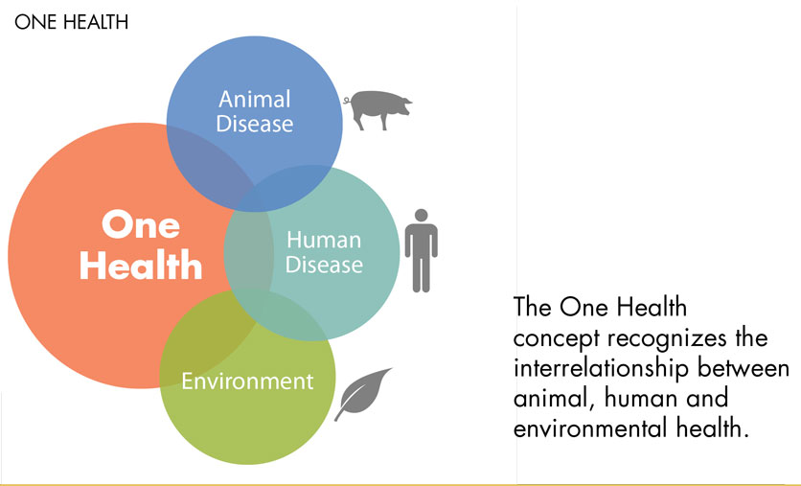
One health concept

Slide 40
Preventive strategies
Primary prevention
Secondary prevention
Tertiary prevention

Slide 41
primary prevention of infectious disease
Seek to prevent new cases of infection from occurring by interrupting the transmission of pathogens to susceptible human hosts, or increasing their resistance to infection
Vaccination

Slide 42
Vaccination
Directly, by increasing the immunity of individuals vaccinated against the pathogen targeted by vaccine
Indirectly, by decreasing potential exposure to a pathogen, by reducing the proportion of susceptible individuals capable of transmitting the infection in the population

Slide 43
secondary prevention of infectious disease
Detect new cases of infectious disease at the earliest possible stage and intervene in ways that prevent or reduce the risk of infection spreading further in the population. Some examples of how secondary prevention can be put into practice are described below.
  Early treatment
  Education and health-related behavior modification
  Screening program

Slide 44
tertiary prevention of infectious disease
Prevent the worst outcomes of a disease in an individual already diagnosed (e.g., rehabilitation)
Although this may greatly improve the quality of life for that person, it has at most a limited impact on the spread of infectious disease
Extremely expensive, compared to prevention of disease

Slide 45
The Danger of Avian Influenza www.youtube.com/watch?v=8RApk1t9XDo

Slide 46
YouTube – A Risk Based Approach to Avian Flu Control in Developing Countries www.youtube.com/watch?v=R9Un5fD5Rlk
A Risk Based Approach to Avian Flue Control in Developing Countries

Slide 47
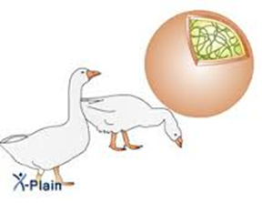
What do you think?
Think about the risk factors, transmission and control of Avian Influenza. List one or two:
  Host-related risk factors
  Virus-related risk factors
  Risk factors related to the environment
  Transmission routes
  control or intervention points

Slide 48
small group assignmentS
For your assigned scenario, discuss potential risk factors, host, agent, environment, mode of transmission, and management of assigned zoonotic diseases
Create a zoonotic disease public awareness plan
Present this information through a conceptual model or map that visualizes this information
CONSIDERING USING AN OPEN SOURCE MAPPING SOFTWARE SUCH AS VISUAL UNDERSTNADING ENVIRONOMENT (VUE)

Slide 49
case studies
Leptospirosis
Streptococcus suis infection
Rabies
Dengue

Slide 50
Disease case summary: leptospirosis
Leptospirosis is a zoonotic waterborne infection caused by the bacteria Leptospira that can affect the liver, kidneys, and central nervous system. Humans can be exposed through contact with water, vegetation or soil contaminated by the urine of infected animals. Possible animal reservoirs include livestock, dogs, rodents, and wild animals. Leptospires enter the body through contact with the skin and mucous membranes and, occasionally, via drinking water or inhalation. Person-to-person transmission is rare. Occurrence of leptospirosis in humans depends on a complex set of interactions between ecological and social factors. Leptospirosis is present worldwide, but more common in tropical and sub-tropical regions where abundant precipitation, regular flooding and high temperatures enhance the distribution and survival of leptospires.
Additional information available in the One Health Compendium.

Slide 51
Disease case summary: Streptococcus suis
Streptococcus suis is an important bacterial cause of zoonotic disease in both swine (pigs) and humans in many areas of the world. The organism may be isolated from healthy pig carriers, but reported infections in pigs due to Streptococcus suis include arthritis, meningitis, pneumonia, septicaemia, endocarditis, abortions and abscesses. Humans at higher risk for infection include persons in direct contact with infected pigs or raw pig-products, including farmers and abattoir workers, and those with pre-existing illness or immunodeficiency. Human infection is thought to occur through cuts or abrasions on the skin, handling infected pig material, or possibly inhalation or ingestion. In humans, infection due to
Streptococcus suis may cause meningitis, endocarditis, pneumonia, septic arthritis, and/or toxic shock–like syndrome.
Information available from the WHO Factsheet: http://www.who.int/foodsafety/micro/strepsuis/en/

Slide 52
Disease case summary: rabies
Rabies is an important preventable zoonotic disease caused by the rabies virus. The disease is endemic in many countries, affects both domestic and wild mammals, and is transmitted to humans through contact with infectious material, usually saliva, via bites or scratches by a rabid animal. Rabies is present on all continents with the exception of Antarctica, but more than 95% of human deaths occur in Asia and Africa, most often following contact with dogs, other canines/carnivores, or bats with rabies infection. Once symptoms of the disease develop, rabies is nearly always fatal; WHO estimates rabies causes 60,000 human deaths per year. The high mortality highlights the importance of the global canine rabies elimination strategy based on dog vaccination. Rabies is 100% preventable, so humans exposed to rabid animals should receive proper wound care and post-exposure prophylaxis including rabies vaccine.
Additional information available in the WHO Fact Sheet: http://www.who.int/mediacentre/factsheets/fs099/en/

Slide 53
Disease case summary: dengue
Dengue is a mosquito-borne viral infection found in tropical and sub-tropical regions around the world. Dengue virus (DENV) exists in four serotypes (DENV 1, 2, 3 and 4). Dengue fever has become a major international public health concern. Severe Dengue (previously known as Dengue Haemorrhagic Fever) was first recognized in the 1950s during epidemics in the Philippines and Thailand. Today, severe dengue affects many Asian and Latin American countries and is leading cause of morbidity, hospitalization and death among children. Control strategies have focused mainly on vector control, and enhanced disease surveillance. No vaccine has yet been shown to be effective against all four DENV serotypes. DENV transmission in forest monkey occurs, but human infection is sufficient to maintain transmission cycles in cities, particularly in crowded urban areas where mosquito vectors breed in uncovered water storage containers, flower vases, metal cans, or in discarded glass bottles, plastic containers or auto tires containing water.
Information available from the WHO Factsheet: http://www.who.int/mediacentre/factsheets/fs117/en/index.html

Slide 54
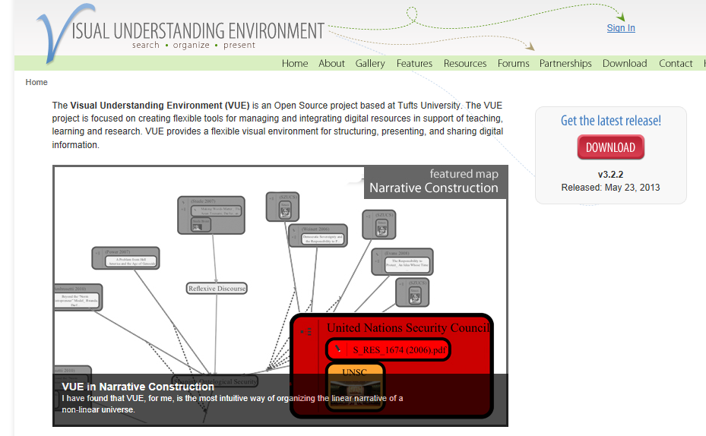
Free down load at: sourceforge.net/projects/tuftsvue/files/latest/download

Slide 55

If you want to go fast, go alone.
If you want to go far, go together.
African Proverb

Slide 56

summary
Prevention and control of infectious diseases is in your hand
Partnership and collaboration is a key to success
The path forward requires a system, resources, and courage

Slide 57
Risk Assessment Principles
Infectious disease management,
one health course

Slide 58
Risk Analysis
Risk Analysis addresses/differentiates between:
Perception vs. Reality
Fate vs. Probability
Risk = Likelihood X Magnitude
Source: D. Travis and B. Wilcox. 2012. MODULE VIII: EMERGING ZOONOTIC DISEASE RISK. EZD Short Course, April 2012, Hanoi

Slide 59
General Concepts of Risk
Identify Hazard(s) = what, specifically, are we concerned about?
Assess Vulnerability = of whom?
Assess Impact = likelihood and magnitude
Source: D. Travis and B. Wilcox. 2012. MODULE VIII: EMERGING ZOONOTIC DISEASE RISK. EZD Short Course, April 2012, Hanoi
Notes:
Risk Analysis is used to add science to policy and/or decision making in order to address real problems
When discussing terms such as "threat" and/or "hazard“, we often mean something that could cause harm.
Risk is associated with the potential that a threat or hazard could exploit vulnerabilities and have an adverse impact
However, the process risk analysis is in essence using a model and there are assumptions in the model. Therefore, it is necessary to be transparent about those assumption and to express the uncertainty associated with those assumptions.

Slide 60
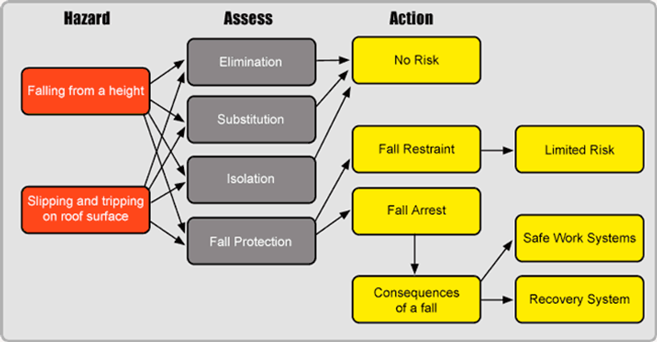
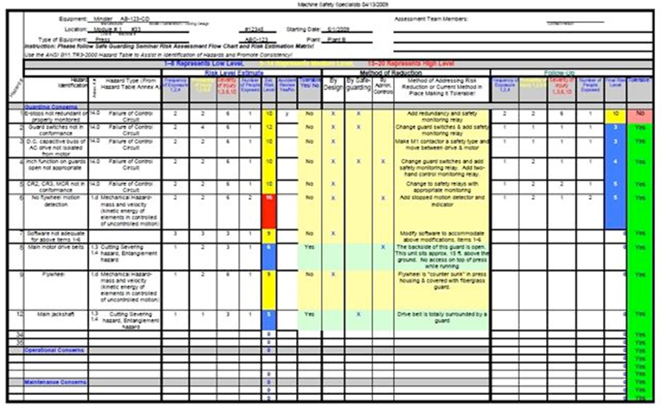
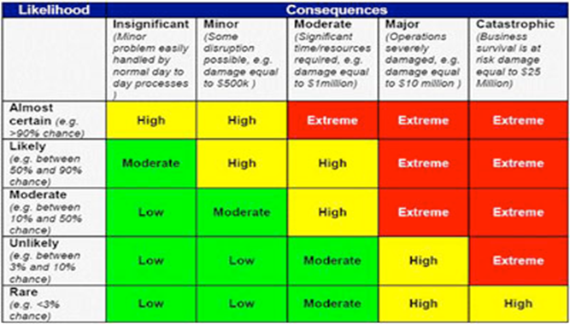
Different TYPES of Risk Analysis
Source: D. Travis and B. Wilcox. 2012. MODULE VIII: EMERGING ZOONOTIC DISEASE RISK. EZD Short Course, April 2012, Hanoi
Notes:
Risk is used in many different fields and although the concept of risk analysis is fairly consistent; the actually process of conducting risk assessment is not the same
Ask the class what types of risk assessments they found.

Slide 61
Risk Assessment Model
Risk = Chance x Hazard x Exposure x Consequence
The quality of the Risk Estimates depends on the quality of the input
Notes:
Risk is the likelihood of identified hazards causing harm in exposed populations in a specified time frame with reference to the severity of the consequence

Slide 62
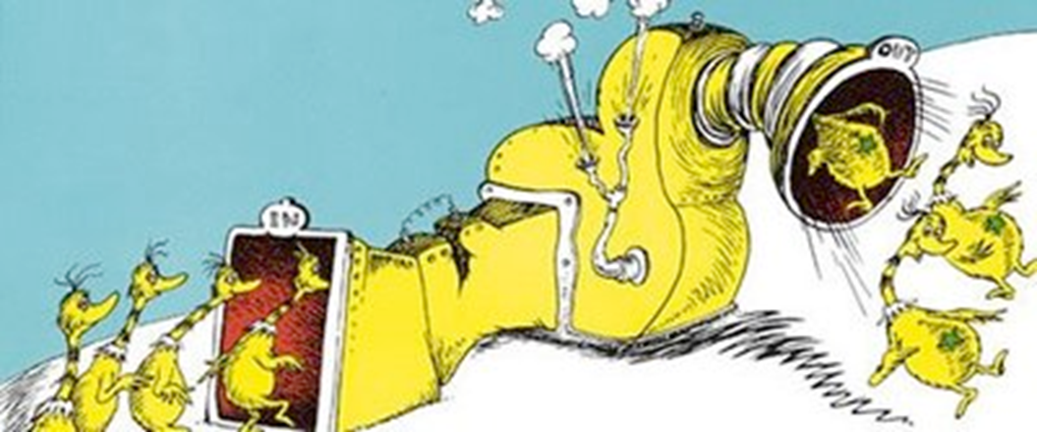
Fundamental Constraints in Risk Analysis
Data Availability/Quality
Great models rarely make data better

Slide 63
Overall Risk Assessment Process
Hazard
Pathway
WHAT
HOW
Assumptions
Rating scale
Uncertainty
Release
Exposure
Consequences
Model
Risk Characterization
Notes:
In general, in a risk assessment a hazard is identified and characterized. Pathways by which receptors could be exposed are examined. Receptors are people or animals that could be exposed. Models are used to calculate the exposure (both concentration and duration) to characterize the potential risk of an adverse outcome.

Slide 64
Risk Assessment Process
Problem Formulation
Hazard Identification
Exposure Assessment
Dose/Response
Risk Characterization
Risk Management
Notes:
These are the general steps taken during the risk assessment process. We will discuss each separately

Slide 65
Problem Formulation
What risk are you going to evaluate?
  What are the chances of wining the lottery?
  What is the risk of getting hit by a meteor?
  What is the risk of getting lung cancer if I smoke three packs of cigarette per day?
  What is the risk of a Nipah virus outbreak in villages in Bangladesh which tap date palm trees?
Notes:
You must generate specific testable questions and recognize the type of data that you would need to collect.

Slide 66
Hazard Identification
Identify the pathogen and human illness and disease
  Characterize the pathogen
  Case fatality
  Transmission routes
  Incubation periods
Notes:
For infectious disease risk assessments the next step is to identify the pathogen and gain an understanding of its dynamics in the environment, animals, and people

Slide 67
Sources of Data
World Health Organization
  International Agency for Research on Cancer (IARC)
USEPA Integrated Risk Information System (IRIS)
Other governmental agencies
Scientific literature
RAIS Risk Assessment Information
Notes:
Depending of the pathogen or contaminant, there are many places to find data. Here are several

Slide 68
Exposure Assessment
Identifies potentially affected population
Determines exposure/transmission pathways
Estimate dose of exposure
Estimate exposure factors such as contact rates and the frequency and duration of exposure
Estimate physiological parameters such as inhalation and ingestion rates, absorption rates, body weight, and life expectancy
Notes:
Exposure Assessment is the next step in the risk assessment process. Fundamentally you need to identify your sources (where/when/what), the pathways of transmission, and your receptorsWhen thinking about the exposure assessment - you should consider whether the conditions allow for transmission. How could be people be exposed?Are there vectors? Are they proliferating? You also want to consider the risk factors in your community – such as Does the population have immunity? Is the community vaccinated? Is the community healthy? Are they adequately fed?

Slide 69
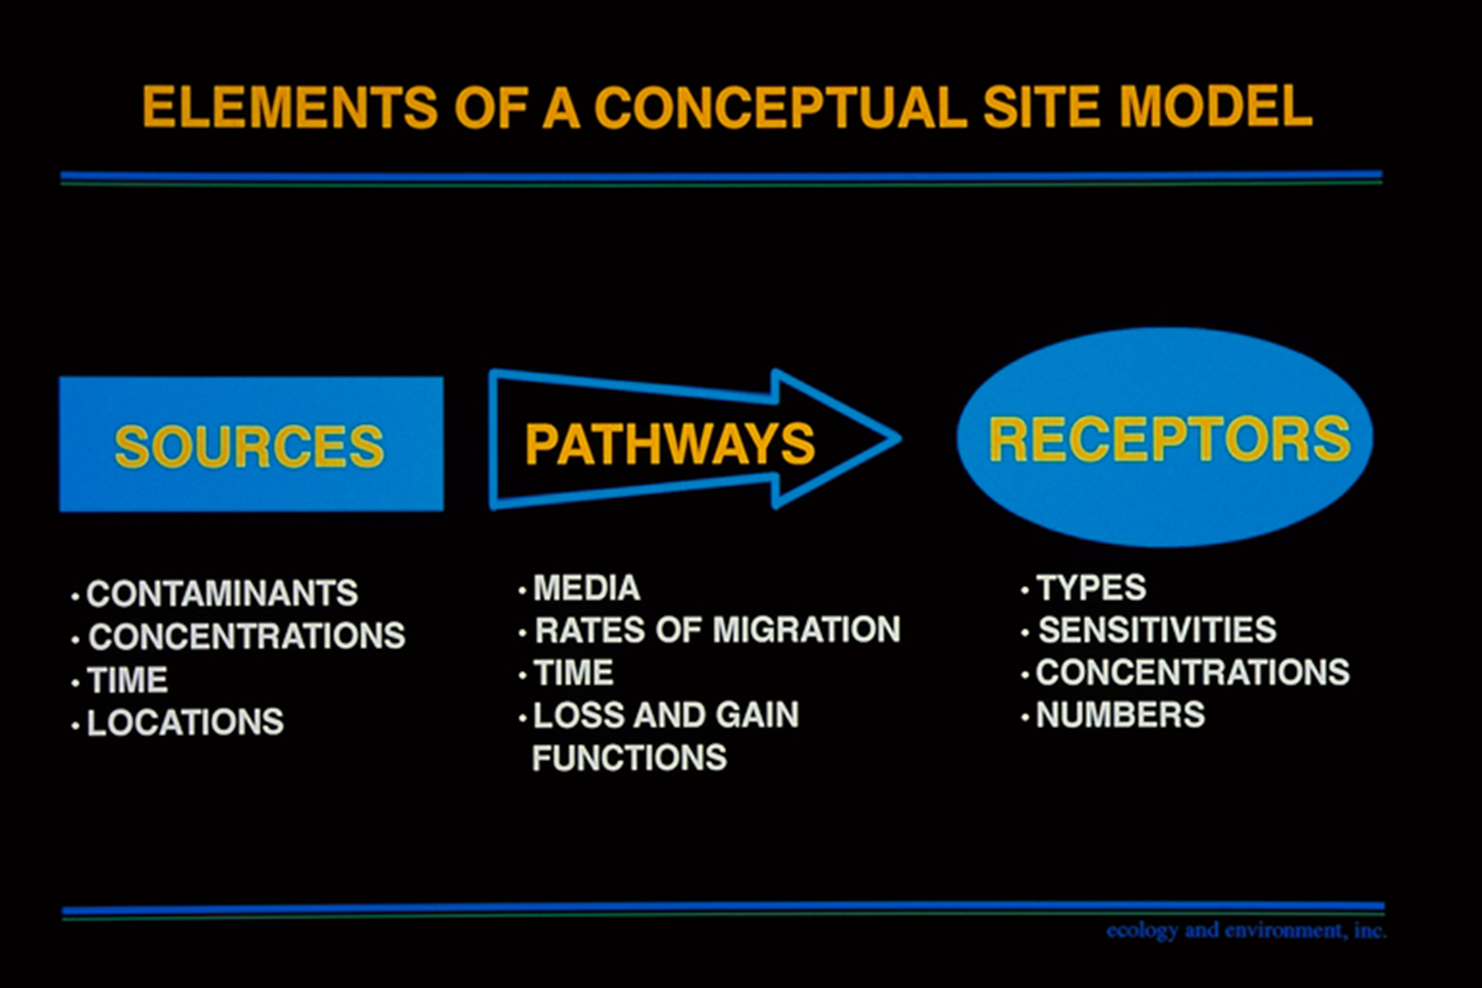
Notes:
In the exposure assessment, you often create a conceptual model of your routes of exposure so that you understand both transmission and exposure pathways. Although the above graphic describes how a conceptual model should be developed for a model where contaminants are involved, the same principles can be applied for a pathogen. Think of the pathogen as a contaminant. The pathways are the exposure/transmission pathways. The receptors are your populations and subpopulations.

Slide 70
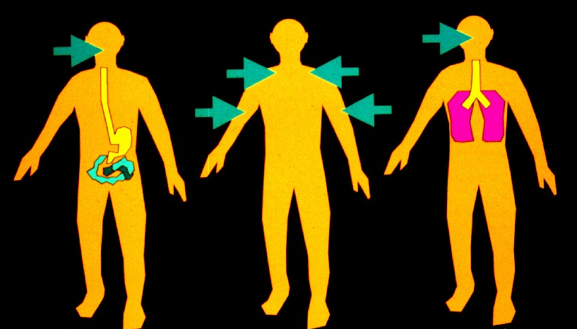
Routes of Exposure
Ingestion Dermal Inhalation
Notes:
Oral, dermal, inhalation routes of exposure

Slide 71
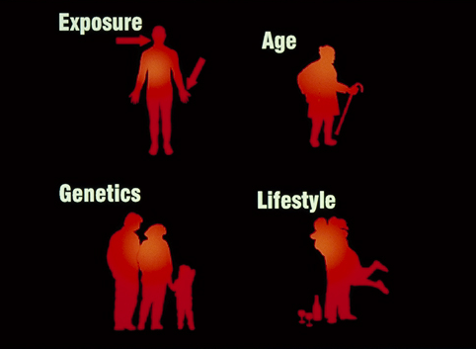
Risk Factors
Notes:
Other factors to consider in how a pathogen could affect a community are the community’s risk factors. Other risk factors include the nutrition, the quality of housing, water quality, sanitation, vaccination, and exposure to disease vectors

Slide 72
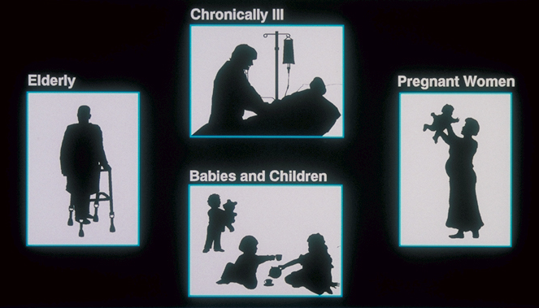
Subpopulations of Potential Concern
Notes:
Subpopulations like the elderly, the chronically, pregnant women, babies and children can be more or less susceptible to certain pathogens.

Slide 73
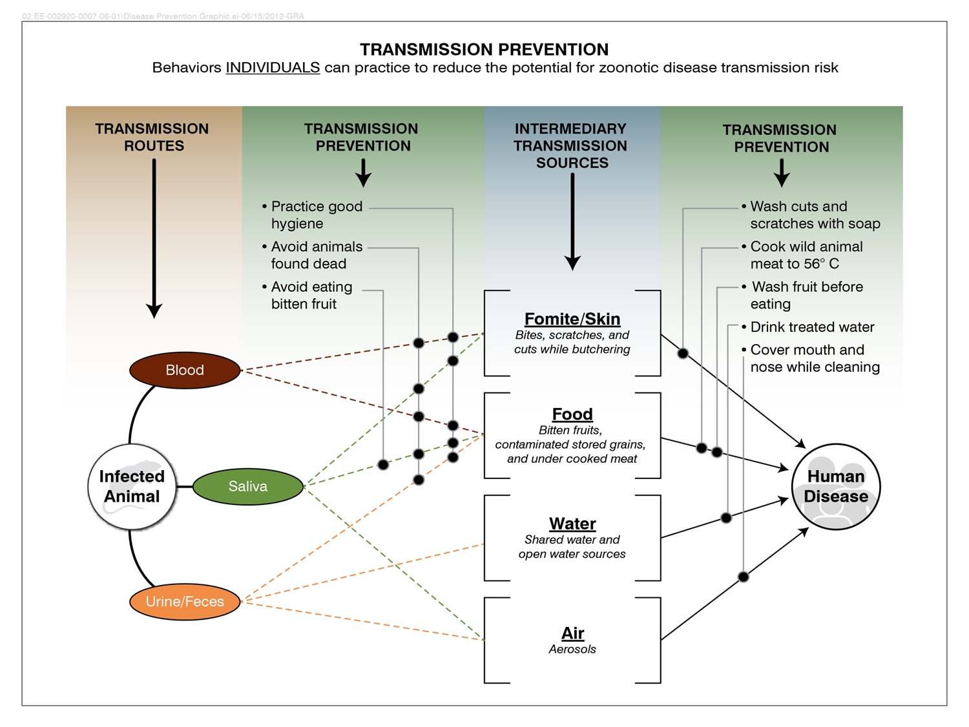
Notes:
This is an example of a conceptual model of transmission from an infected animal to people through multiple different transmission pathways. How would you refine a model like this to include the populations that could be exposed and the susceptible subpopulations? If the pathogen was rabies, what would be the routes of exposure? Who would be the susceptible populations? For a pathogen such as Nipah virus, what would be your source? What would be the exposure pathways? Do you have intermediary transmission sources? Who have been the populations at risk?

Slide 74
Dose Response
Quantitative relationship between likelihood of adverse effects and the level of exposure
  Invective Dose – ID₅₀
  Lethal Dose - LD₅₀
Notes:
For the pathogen of concern, you need to calculate the risk of response given a known dose of a pathogen. Information that you may use includes the -
ID50 -the amount of pathogenic microorganisms that will cause infection in 50 per cent of the test subjects
LD50 - the quantity of an agent that will kill 50 per cent of the test subjects
http://medical-dictionary.thefreedictionary.com/infectious+dose+50+(ID50)

Slide 75
All substances are poisons;
There is none which is not a poison.
The right dose differentiates
A poison and a remedy.
Paracelsus
(1493-1541)
Notes:
Keep this in mind especially when you are thinking doses. People have died from drinking too much water.

Slide 76
Risk Characterization
Summarize the numerical risk estimates for all exposure scenarios and receptor groups evaluated
Identify the major risks, and the pathways and chemicals most responsible
Review the nature of the potential adverse health effects
Notes:
Risk is characterized by using models of exposure and dose to determine the chance of an adverse outcome. The analysis is only as good as the model and as we discussed previously you also need high quality data.

Slide 77
Infectious Disease Risk Analysis Factors
Agent or
Disease
Route(s) of transmission
Methods of exposure or contact
Result of contact
Population
Dynamics
Pathogenicity
Potential for spread
Agent class
Air borne
Direct contact
Vector borne
Cross contamination
Infectivity (ID50)
Reservoir
Virulence (LD50)
Environmental factors contributing to agent survivability
Exposure dose
(Amount X Time X Route)
Host susceptibility
Notes:
This diagram summarizes some of the factors that should be considered when conducting an infectious disease risk analysis

Slide 78
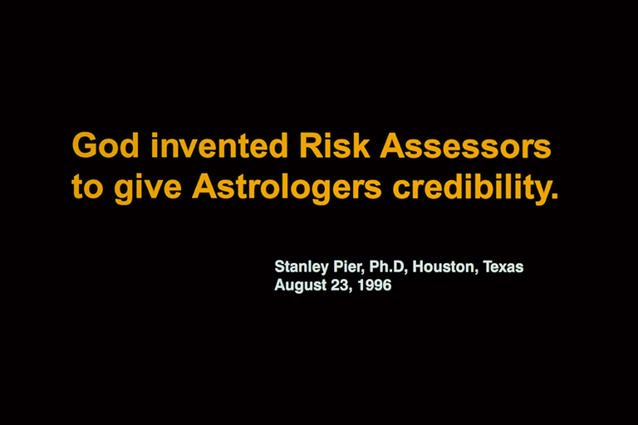

Slide 79
Risk Management
Process of evaluating alternative options and selecting among them; a risk assessment may be one of the bases of risk management
Notes:
Part of the process is understanding what are the most important variables are that have the greatest effect on the risk. But it also involves understanding the different potential scenarios and their outcomes and their cost effectiveness (cost-benefit analysis). It is also necessary to adapt to changing situations and that a single response may not be effective therefore it is necessary to re-assess (adaptive management)

Slide 80
Risk Communication
Audience:
Management
Government
Public
Notes:
Risk Communication needs to be tailored to your audience and therefore you have to have an appreciation of your audience’s perspective. Although everyone is going to what could happen to them, they also will want to the potential effects to their organizations and what would be the perception if they did or did not act. Remember that most people are willing to accept that they consciously make, such as smoking, drinking alcohol, or jumping out of a plane; however, they are reluctant to accept risk over which they have no control.

Slide 81
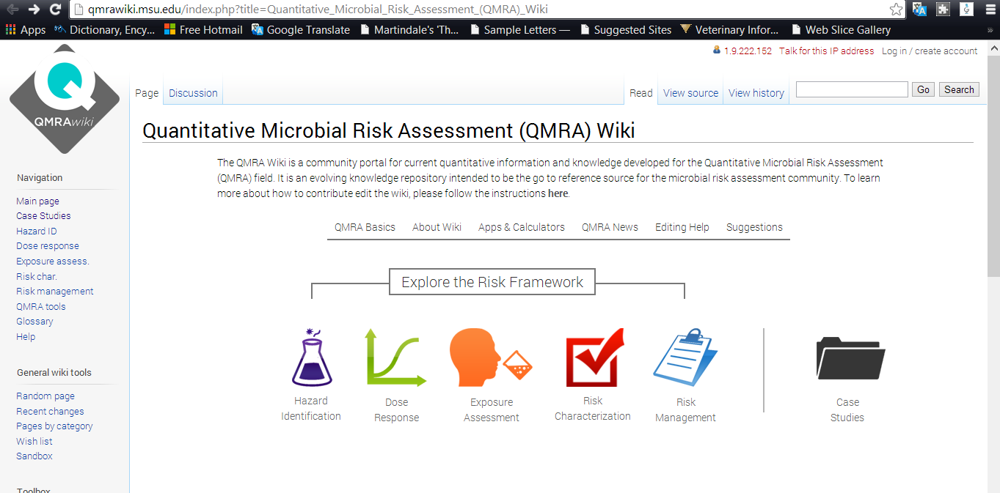
Risk Assessment: QMRA Wiki
Quantitative Microbial Risk Assessment (QMRA) Wiki
Notes:
Go to the link http://qmrawiki.msu.edu/index.php?title=Quantitative_Microbial_Risk_Assessment_(QMRA)_Wiki and show how it works. Also examples of case study through: http://qmrawiki.msu.edu/index.php?title=Quantitative_Microbial_Risk_Assessment_(QMRA)_Wiki

Slide 82
Exercise
In teams of 4 or 5, review one of the case studies from http://qmrawiki.msu.edu/index.php?title=Case_Studies#tab=QMRAII_Workshop
Each group has 30 minutes to review a case study and determine what type of data was used in each component, and what was the source of the data.
Be prepared to present your results

Slide 83
Collect Community-Based Data to Support Infectious Disease Investigations or Risk Assessments
Infectious disease management,
one health course

Slide 84
Field trip
Guideline is available in http://www.uic.edu/depts/crwg/cwitguide/04_EvalGuide_STAGE2.pdf (Method 7)
Purposes
  To learn about the types of information that can be obtained using data collected about a community
  To understand when community measures are useful to evaluation

Slide 85
Field Trip
Advantages
  Evaluate the issue the context of a community
  Help in understanding the broader impact of the issue
  Some types of data are collected regularly and are publicly available

Slide 86
Field Trip
Disadvantages
  Data may be difficult or time-consuming to locate
  May be limited to qualitative data
  Data are limited to what has already been collected previously and may not be relevant

Slide 87
field trip assignment
Prior to the field trip, learn about disease (e.g., acute gastroenteritis due to E. Coli or other infectious agent)
Assume outbreak in the neighboring community among school-aged children and elderly. The potential source of the E. Coli outbreak is under-cooked hamburger meat served in institutional settings. It is possible that same batch of hamburger patties was sent to community, but no method to check batch numbers. What is the risk of outbreak in this community? Create a plan to:
  Determine what are the important issues about E. Coli and impact possible in community
  What are potential points of exposure?

Slide 88
Preparing for A Field Trip
Steps for planning to use community measures
  Review the objectives and research questions to determine whether community measures are useful to your evaluation
  Determine the type of data about the community that would be useful to obtain
  Evaluate the available data and determine if additional information is needed
  Design appropriate, standardized instrument to collect data, pilot test and train on the use of questionnaire
  Conduct data collection
  Obtain proper permission from local health authorities, keep village elders informed (consider using local guide)

Slide 89
Field Trip
Tips for using community measures
  Community data are available from a variety sources i.e. agency, www, government, local government
  Pay attention to how, when, and where the data was collected
  Interpreting data that was not collected by others requires caution

Slide 90
Develop a risk assessment
Assemble the data gathered from the community and from other sources
  Characterize the hazard
  What are the potential sources and exposure pathways in the community
  What is the important information about dose for this pathogen
  How would you characterize the potential risks in this community

Slide 91
Developing Infectious Disease and Public Awareness Materials
Infectious disease management,
one health course

Slide 92
Topics FOR TODAY’s DISCUSSION
Key Concepts
Components:
Audiences
Messages
Materials/approaches
Example(s)

Slide 93
Key concept
Public awareness:
  Informing
  Sensitizing
  Drawing attention of community to a particular issue through awareness materials

Slide 94
Audiences
To have effective material, target audiences should be carefully identified
Some educational topics, material and approaches may suit a broad spectrum of audiences, but in other activities should be tailored to a specific audience
Consider a One Health perspective

Slide 95
Type of audiences
  Children/Teenagers/Adults
  General / specific audiences
  Government sectors

Slide 96
Messages
Messages delivered should be appropriate for each target audience
After analyzing your audience, design and package your messages accordingly
Standard rules:
  Keep it simple and short, but interesting
  Avoid unnecessary/ meaningless words

Slide 97
Preparing effective messages
Concise: As few words as possible, but no fewer
Clear: Your grandparents can understand it
Compelling: Explains the problem
Credible: Explains how you solved the problem
Conceptual: Not unnecessary detail
Concrete: Specific and tangible
Customized: Addresses audience’s interests
Consistent: Same basic message
Conversational: Aims to engage the audience

Slide 98
key contents
General information about infectious diseases
Pathogen
Host
Vector
Route(s) of transmission/transmission dynamics
Disease symptoms
Risk factors
Protection and prevention

Slide 99
Materials/approaches
Seminars/ workshops/ conferences
Exhibitions
Publications (posters, guidelines, flyers, brochures, booklets, activity books, paper models, comic books, story books, coloring books)
Public awareness events (Visitors' / field days)
Media (newspapers, radio, TV)
Websites and other internet based tools
Social media (Facebook, Twitter, YouTube, LinkedIn, blogs)
Performing and cultural arts (plays, dances, poems, songs, street theatre, puppet theatre)
International day

Slide 100
Seminars, workshops and conferences
Discussions with target audiences on specific themes
  Develop common understanding
  Develop strategy or plan action
  Improve interaction
  Ensure participation in decision-making
  Facilitate identification of problems
Deliver general information to target audiences
Invite questions and discussion from audiences

Slide 101
Exhibitions
Present and demonstrate the information to mixed audience in various ways
Allow interaction with public
Inform and get instant feedback
International, national and local exhibitions
Create general public awareness
Attract government and public support
Providing info on org and its activities
    Promote networking
Identify new clients/beneficiaries and potential partners

Slide 102
Visitors and Field days
Gather information about target audience(s)
Develop message to meet their interests
Decide how to present message
      Wall-mounted exhibits
      Posters
      PowerPoint presentations
      Automatic audio-visuals/computer displays practical demonstrations, field tours
Provide comfortable environment
      Space for face-to-face interaction
      Seats for longer discussions

Slide 103
Social media
Good way to engage and maintain relationships with the public
Use various tools to deliver targeted message: Facebook, Twitter, YouTube, LinkedIn, Blogs
Agree with your team about which tools are to be used
Can be demanding, requires dedication
    Keep engaged, innovative, up-to-date
    Follow-up on messages/requests; Check on your contacts
    Feed your blog posts
Engage prominent personalities

Slide 104

Example of public awareness material

Slide 105
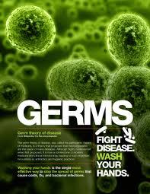
Example of public awareness material
Source: ericaglasier.com

Slide 106
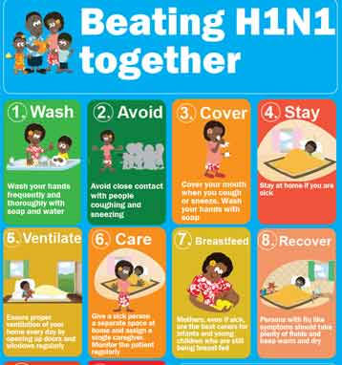
Example of public awareness material
Source: unicef.org

Slide 107
Assignment
Develop a public awareness message
What is the infectious disease that you want to conduct the public awareness for?
Who is the target audience(s)?
What are the messages that you want to deliver to the target audience(s)?
What is the best method for relaying these messages? What types of materials are appropriate?
How might we adapt the material to the target audience(s)?

Slide 108
Deliver your public awareness message
Create a plan for delivering your public awareness message at a specific activity:
Location
Objectives
Audient profile
Primary issues to be discussed or highlighted
Speakers or other participants
Target number of expected attendees
Language to be used
Documents and materials to be distributed

Slide 109
debriefing
What problems did you encounter when you introduced the material to the target audience(s)?
How well did the target audience(s) understand the messages delivered by your material?
What was the feedback you received from the audience(s)?

Slide 110
Critique of an Infectious Disease Management Plan from a
One Health Perspective
Infectious disease management,
one health course

Slide 111
Townsend article
What led to the introduction of rabies in Bali, Indonesia?
What are possible interventions to consider including in a rabies management plan?
What is R₀? What is the calculated R₀ for rabies in this paper?
Reduction of dog density is discussed as a possible rabies management measure. What do the authors conclude about this for a management plan and why?
What are the dog vaccination campaigns discussed in the paper and how would their use in a management plan vary?

Slide 112
Townsend article (continued)
In what ways does the rabies management plan discussed in the paper use a One Health approach?
What aspects of this management plan could be improved from a One Health perspective?

Slide 113
Systemic Effects of a
Disease Management Plan
Infectious disease management,
one health course

Slide 114
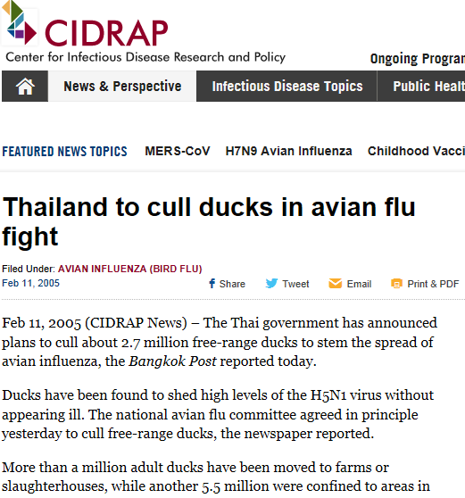

Slide 115
Discussion questions
Why are ducks important to consider in the transmission of avian influenza?
How many ducks contribute to the spread of avian influenza to humans?
Why was duck culling part of the management plan for controlling avian influenza in Thailand?

Slide 116
Infectious Disease Surveillance
Infectious disease management,
one health course

Slide 117
learning objectives
Understanding core concepts in surveillance methods
Describe the components and methods for evaluating public health surveillance system

Slide 118
effective: “SMART” Objectives
S = strategic
M = measurable
A = adaptable
R = responsive
T = targeted

Slide 119
objectives of “smart” Disease Surveillance
Identify key drivers of zoonotic disease emergence
Detect disease outbreaks
Forecast events that may lead to disease emergence
Assist governments in the development of preventive strategies
Establish a sustainable, global early-warning

Slide 120
Objectives of public health surveillance
To reduce morbidity, mortality and to improve the public’s health
To guide logical and effective public health action, based on timely and accurate information
Strengthen program planning and evaluation
Formulate priorities, research hypotheses

Slide 121
EXAMPLES of types and SOURCES of DISEASE surveillance data
Field surveillance: data collected in the field, both quantitative and qualitative data
Digital surveillance data: data collected through automatic web-based monitoring
Active surveillance: enhanced activities to search for new or existing cases of disease at a health facility or in community

Slide 122
components of DISEASE surveillance: core activities
Detection
Registration
Reporting
Confirmation
Analysis
Feedback

Slide 123
components of DISEASE surveillance: support activities
Communication
Training
Resource Promotion
Supervision

Slide 124
Purpose of evaluating public health surveillance systems
…to ensure that problems of public health importance are being monitored efficiently and effectively
… to ensure that managers have accurate and timely health information to enable “informed” decision-making to improve disease prevention & control activities

Slide 125
Evaluating public health surveillance systems
Public health surveillance systems should be evaluated periodically, and the evaluation should result in recommendations useful to improve the quality, efficiency, and usefulness of disease prevention and control activities

Slide 126
Evaluation of disEase surveillance systems: Selected criteria
Simplicity
Flexibility
Acceptability
Sensitivity
Specificity
Accuracy
Positive predictive value
Representativeness
Sustainability
Timeliness

Slide 127
simplicity: definition
The simplicity of a public health surveillance system refers to both its structure and ease of operation
Disease surveillance systems should be as simple as possible while still meeting their objectives

Slide 128
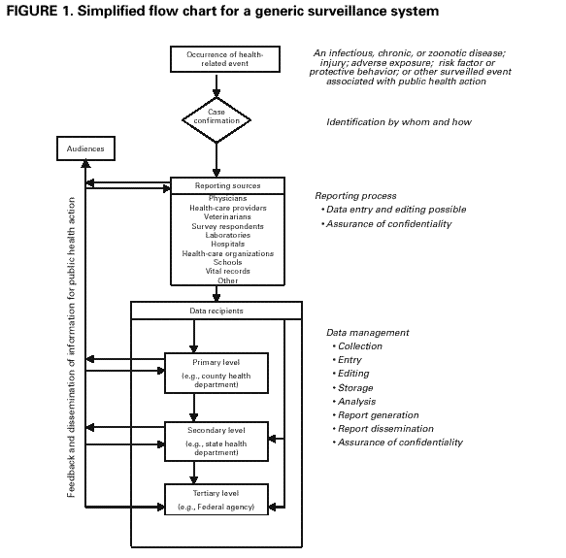

Slide 129
flexibility: definition
A flexible public health surveillance system can adapt to changing information needs, operating conditions, or new diagnostic tests or criteria -- with little additional time, personnel, or allocated funds.

Slide 130
flexibility: definition
Flexible systems can accommodate, for example, new health-related events, changes in case definitions or technology (including new diagnostic tests, rapid tests), and variations in funding or reporting sources
Use of standard data formats (e.g., in electronic data interchange) can be integrated with other systems

Slide 131
flexibility: methods
Flexibility is probably best evaluated retrospectively by observing how a system has responded to a new demand
Animal and human health professionals are an excellent source of information about disease surveillance systems

Slide 132
data quality: definition
Data quality reflects the completeness and validity of the data recorded in the public health surveillance system

Slide 133
data quality: methods
Examining the percentage of "unknown" or "blank" responses to items on surveillance forms is a straightforward and easy measure of data quality
A full assessment of the completeness and validity of the system's data might require a special study

Slide 134
data quality: methods
Data values recorded in the surveillance system can be compared to "true" values:
  a review of sampled data
  a special record linkage
  patient interview
  calculation of sensitivity and predictive value positive

Slide 135
acceptability: definition
Acceptability reflects the willingness of persons and organizations to participate in the surveillance system

Slide 136
acceptability: methods
Quantitative measures of acceptability:
Subject or agency participation rate (if it is high, how quickly was it achieved?)
interview completion rates and refusal rates (if the system involves interviews)
Completeness of report forms
Physician, laboratory, or hospital/facility reporting rates

Slide 137
acceptability: methods
Accurate
Consistent
Complete
Timely

Slide 138
factors influencing acceptability
The public health importance of the health-related event
Acknowledgment by the system of individual contributions
Dissemination of aggregate data back to reporting sources and interested parties

Slide 139
factors influencing acceptability
Responsiveness of the system to suggestions or comments
Burden on time relative to available time
Ease and cost of data reporting
Federal and state statutory assurance of privacy and confidentiality

Slide 140
factors influencing acceptability
The ability of the system to protect privacy and confidentiality
Federal and state statute requirements for data collection and case reporting
Participation from the community in which the system operates

Slide 141
sensitivity: definition
First, at the level of case reporting, sensitivity refers to the proportion of cases of a disease (or other health-related event) detected by the surveillance system
Second, sensitivity can refer to the ability to detect outbreaks, including the ability to monitor changes in the number of cases over time

Slide 142
sensitivity: methods
Certain diseases or other health-related events occurring in the population under surveillance
Cases of certain health-related events are under medical care, receive laboratory testing, or are otherwise coming to the attention of institutions subject to notifiable disease reporting requirements

Slide 143
sensitivity: methods
The health-related events will be diagnosed/ identified, reflecting the skill of health-care providers and the sensitivity of screening and diagnostic tests (i.e., the case definition)
The case will be reported to the disease surveillance system

Slide 144
positive predictive value: definition
Predictive positive value (PPV) is the proportion of reported cases that actually have the disease of interest or health-related event or condition under surveillance

Slide 145
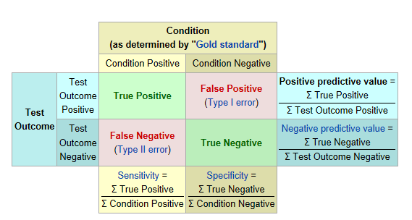
positive predictive value: methods
Source: wikipedia.com

Slide 146
representativeness: definition
A disease surveillance system is representative if it accurately describes the occurrence of a disease or other health-related event, and the reported distribution of disease accurately represents that occurring in the population by time, place and person

Slide 147
representativeness: methods
Representativeness is assessed by comparing the characteristics of reported events to all such actual events
Representativeness can be examined through special studies that seek to identify a sample of all cases
One aspect to consider is what proportion of all districts or provinces actually report the disease

Slide 148
timeliness: definition
Timeliness reflects the speed between steps in a public health surveillance system:
For example, in cases with disease of interest: the time interval(s) between date of symptom onset, or hospitalization, or diagnosis vs. the date case was reported to disease surveillance system

Slide 149
timeliness: methods
The timeliness of a public health surveillance system should be evaluated in terms of availability of information useful to improve control of a health-related event, including prevention of high risk exposures, implementation or strengthening early diagnosis or vaccination, as well as program planning

Slide 150
timeliness: methods
Increasing use of electronic data collection from reporting sources (e.g., an electronic laboratory-based surveillance system) or via the Internet (a web-based system), or use of electronic data interchange by surveillance systems, may promote timeliness
Internet security, confidentiality, privacy and limiting access to only authorized personnel must be considered

Slide 151
stability: definition
Stability refers to the reliability (i.e., the ability to collect, manage, and provide data properly without failure) and availability (the ability to be operational when it is needed) of the public health surveillance system over time, independent of challenges posed by availability of funding, resources, or other changes

Slide 152
stability: methods
The number of unscheduled outages and down times for the system's computer
The costs involved with any repair of the system's computer, including parts, service, and amount of time required for the repair
The percentage of time the system is operating fully
Is the system able to function even after funding or other resources become limited?

Slide 153
stability: methods
The desired and actual amount of time required for the system to collect or receive data
The desired and actual amount of time required for the system to manage the data, including transfer, entry, editing, storage, and back-up data
The desired and actual amount of time required for the system to release data

Slide 154
Assignment: surveillance websites
Select a surveillance website
  WHO http://www.who.int/topics/public_health_surveillance/en/
  U.S. CDC http://www.cdc.gov/surveillancepractice/
  ECDC http://www.ecdc.europa.eu/en/activities/surveillance/Pages/index.aspx
Answer the questions on the following slides
Prepare a 10-minute presentation

Slide 155
questions
What is the population under surveillance?
What is the period of time of the data collection?
What data are collected and how are they collected?
What are the reporting sources of data for the system?

Slide 156
questions
How are the system's data managed
(e.g., the transfer, entry, editing, storage, and back up of data)?
Does the system comply with applicable standards for data formats and coding schemes? If not, why?

Slide 157
questions
How are the system's data analyzed and disseminated?
What policies and procedures are in place to ensure patient privacy, data confidentiality, and system security?
What is the policy and procedure for releasing data?

Slide 158
questions
Do these procedures comply with applicable federal and state statutes and regulations, and/or international standards? If not, why?
Does the system comply with an applicable records management program? For example, are the system's records properly archived and/or disposed of?

Slide 159


questions
Are these surveillance systems (WHO, US CDC or ECDC) effective? Why is it effective? or Why is it not effective?

Slide 160
summary
All public health surveillance systems should be evaluated periodically
No perfect system exists; tradeoffs must always be made
Each system is unique and must balance benefits versus personnel, resources, and costs required
Ensure use of evaluation findings and share lessons learned
Systems should be an excellent source of accurate and timely information for program managers

Slide 161
Analyzing Surveillance Data using HealthMap
Infectious disease management,
one health course

Slide 162
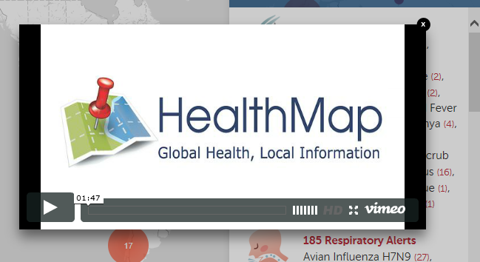
www.healthmap.org

Slide 163
Healthmap data assignment
Select a disease that has more than 10 reports globally or in your region of interest
Look at surveillance data for the past year
Collect the following information
  Disease
  Countries included (can be national, regional or global)
  Species of host affected
  Total reports of the disease for the year
  Total cases of disease in each affected species

Slide 164
Report to a local health department: assignment
Prepare a 15 to 20 minute mock scientific report that you will give to a local health department concerned with the disease:
Using surveillance data perform the following analysis:
  Provide pertinent background information about the disease
  Create a global, regional, or country level map showing the outbreaks for the year
  Create a chart or other graphic to display the number of cases or outbreaks reported by week or by month
  Create a chart or other graphic to display the number of cases by host species over the year

Slide 165
Report to a local health department assignment (continued)
Using surveillance data perform the following analysis:
  Analyze data in the disease reports to determine likely sources and numbers of disease reports
  Analyze data in the disease reports to determine likely sources of the disease and transmission routes
  Create a map, system diagram, or other visual aid to show transmission and risk factors gathered from the disease surveillance data
  Form a conclusion from the surveillance data about the current status of the disease. Include any information collected about control of intervention measures mentioned in the reports

Slide 166
Developing a Management and Surveillance Plan
Infectious disease management,
one health course

Slide 167
h5N1 scenario
The first reports:
Rumors of an outbreak of unusually severe respiratory illness in two villages in a remote province prompted the World Health Organization (WHO) to dispatch a team to investigate. The team found that people in the villages had been falling sick for about a month and that the number of persons with acute illness (i.e., “cases”) had increased each day. The team was able to identify at least 50 cases over the previous month; all age-groups had been affected. Twenty patients are currently in the provincial hospital. Five people have already died of pneumonia and acute respiratory failure.

Slide 168
h5N1 scenario (continued)
Specimens sent to the laboratory to establish etiology:
Surveillance in surrounding areas was enhanced, resulting in new cases being identified throughout the province. Respiratory specimens collected from several case-patients were tested at the national laboratory and found to be positive for type A influenza virus. Isolates sent to the WHO Reference Centre were found to be a subtype of an influenza A (H5N1) never isolated from humans before. Gene sequencing studies further indicate that most of the viral genes are from a bird influenza virus, with the remaining genes derived from a human strain. More cases appeared in surrounding towns and villages.

Slide 169
h5N1 scenario (continued)
Spread to neighboring countries and quarantine attempts:
The new strain of influenza virus begins to make headlines in every major newspaper, and becomes the lead story on news networks. Countries are asked by WHO to intensify influenza surveillance and control activities. Key government officials throughout the region are briefed on a daily basis, while surveillance is intensified. Over the next two months, outbreaks began to take place in neighboring countries. Although cases are reported in all age-groups, young adults seem to be the most severely affected. One in every 20 patients dies. The rate of spread is rapid, and countries initiate travel restrictions and quarantine measures.

Slide 170
h5N1 scenario (continued)
Social effects:
Educational institutions are closed. Widespread panic begins because supplies of antiviral drugs are severely limited and a suitable vaccine is not yet available. One week later, there are reports that the H5N1 virus has been isolated from airline passengers with respiratory symptoms arriving from affected countries.

Slide 171
h5N1 scenario (continued)
Other continents affected:
A few weeks later, the first local outbreaks are reported from other continents. Rates of absenteeism in schools and businesses begin to rise. Phones at health departments ring constantly. The spread of the new virus continues to be the major news item in print and electronic media. Citizens start to clamor for vaccines, but they are still not available. Antiviral drugs cannot be obtained. Police departments, local utility companies and mass transit authorities experience significant personnel shortages that result in severe disruption of routine services. Soon, hospitals and outpatient clinics are critically short-staffed as doctors, nurses and other healthcare workers themselves become ill or are afraid to come to work.

Slide 172
h5N1 scenario (continued)
Other continents affected (continued):
Fearing infection, elderly patients with chronic medical conditions do not dare to leave home. Intensive care units at local hospitals are overwhelmed, and soon there are insufficient ventilators for the treatment of pneumonia patients. Parents are distraught when their healthy young adult sons and daughters die within days of first becoming ill.
Several major airports close because of high absenteeism among air traffic controllers. Over the next 6-8 weeks, health and other essential community services deteriorate further as the pandemic sweeps across the world.

Slide 173
h5N1 scenario (continued)
Assignment
What is your role in this scenario?
What is the role of each stakeholder in this scenario?
How does the scenario affect the stakeholder that you are representing?
How can each stakeholder’s response to the infectious disease in this scenario influence the management of the disease?
Who are the other stakeholders you will need to deal with in order to manage a particular infectious disease?

Slide 174
h5N1 scenario (continued)
Roles
Villagers of Village 1 and 2
Healthcare workers
WHO team
Laboratory workers
Government officials
Transportation security administrator

Slide 175
What do you think?
How effective was the One Health team in developing the management plan for the scenario disease?
What were the problems encountered from the perspective of each stakeholder?
What soft skills are needed to ensure a high functioning One Health team?

Slide 176
Module Review
Management, One Health Course

Slide 177
One thing..
…. That you liked/believed was a strength of the module.
…. That you would suggest we change
Thank you.

